Slide 1
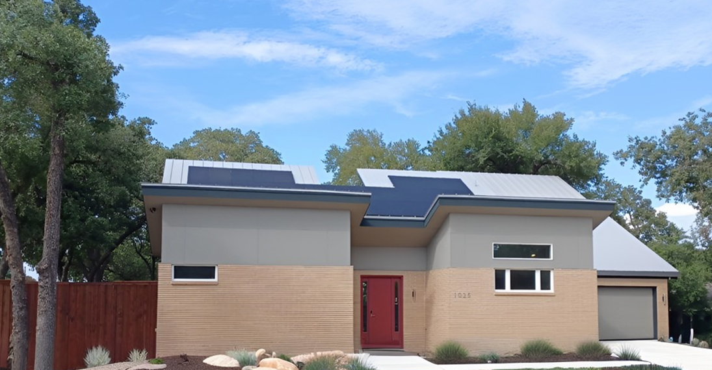
The Byrom Net Zero Energy House

Slide 2
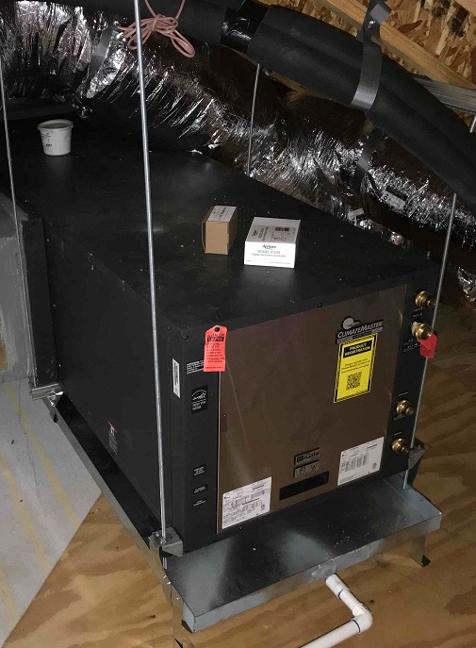
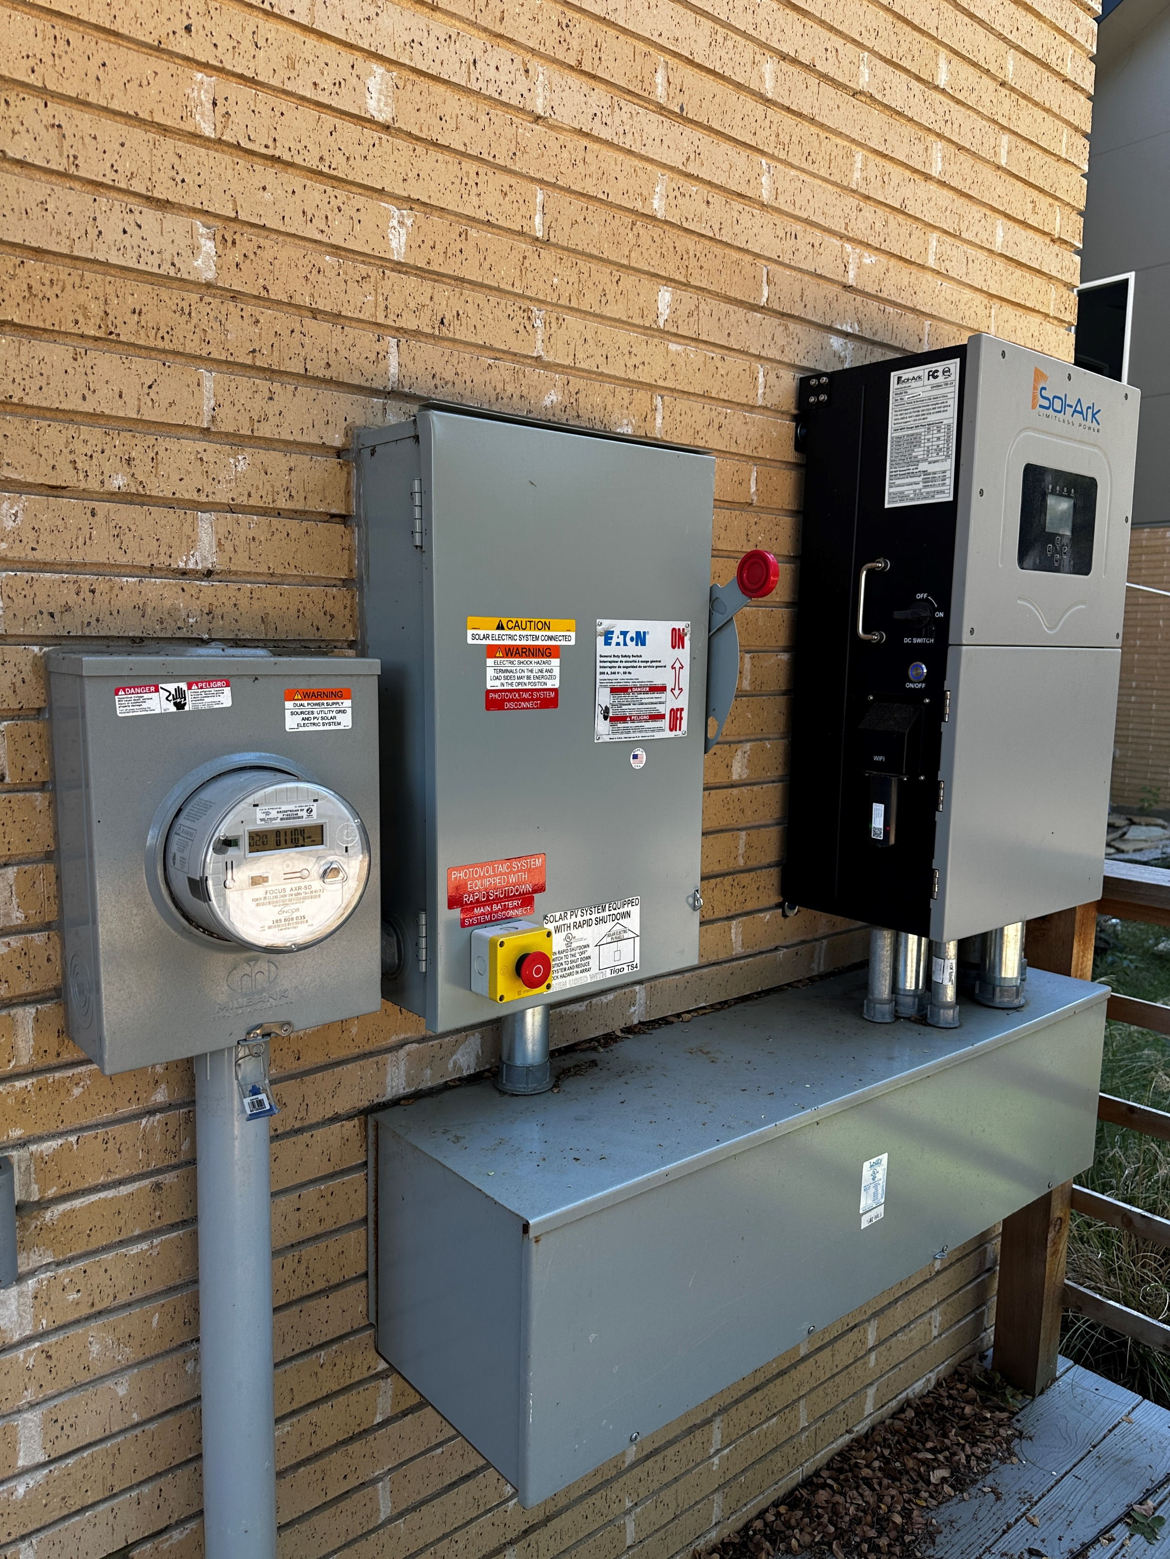
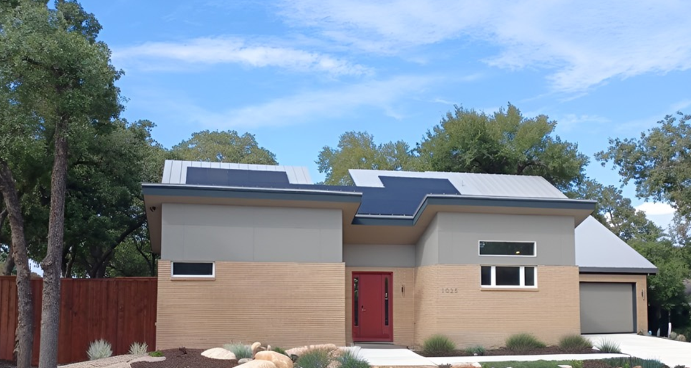
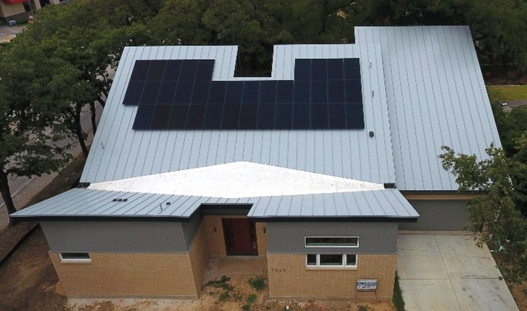
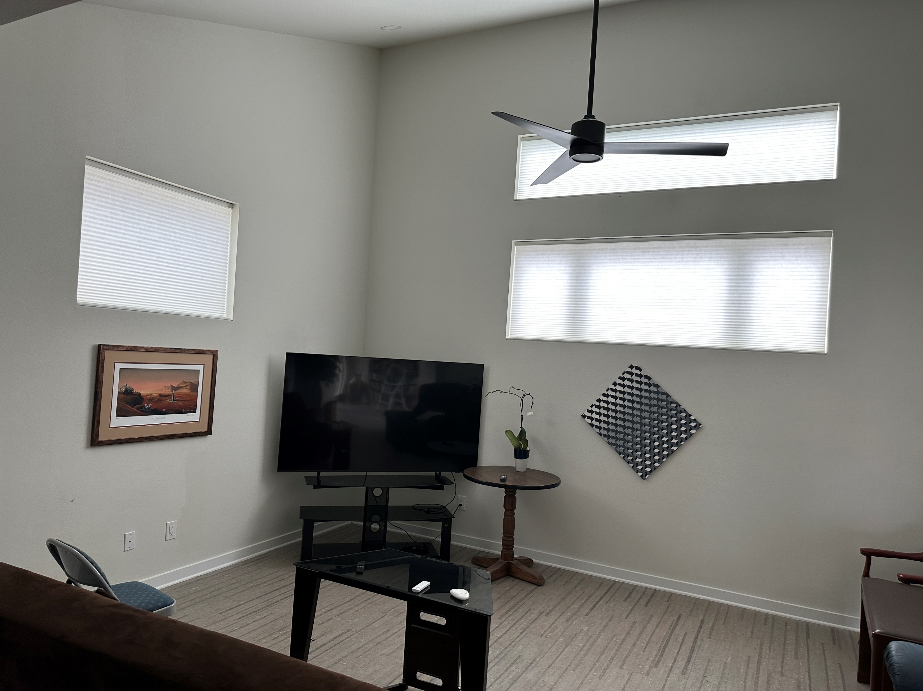
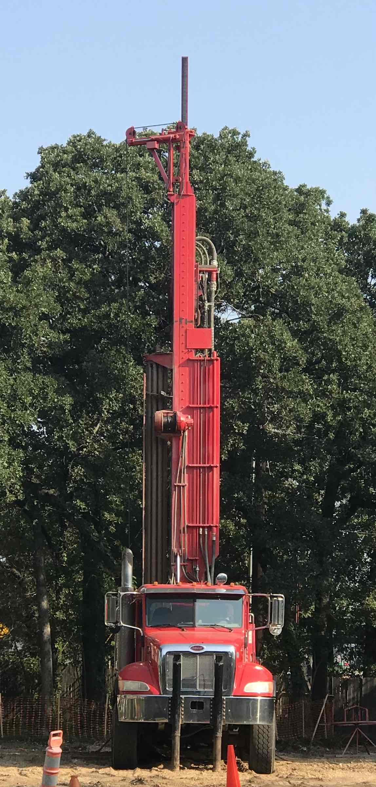

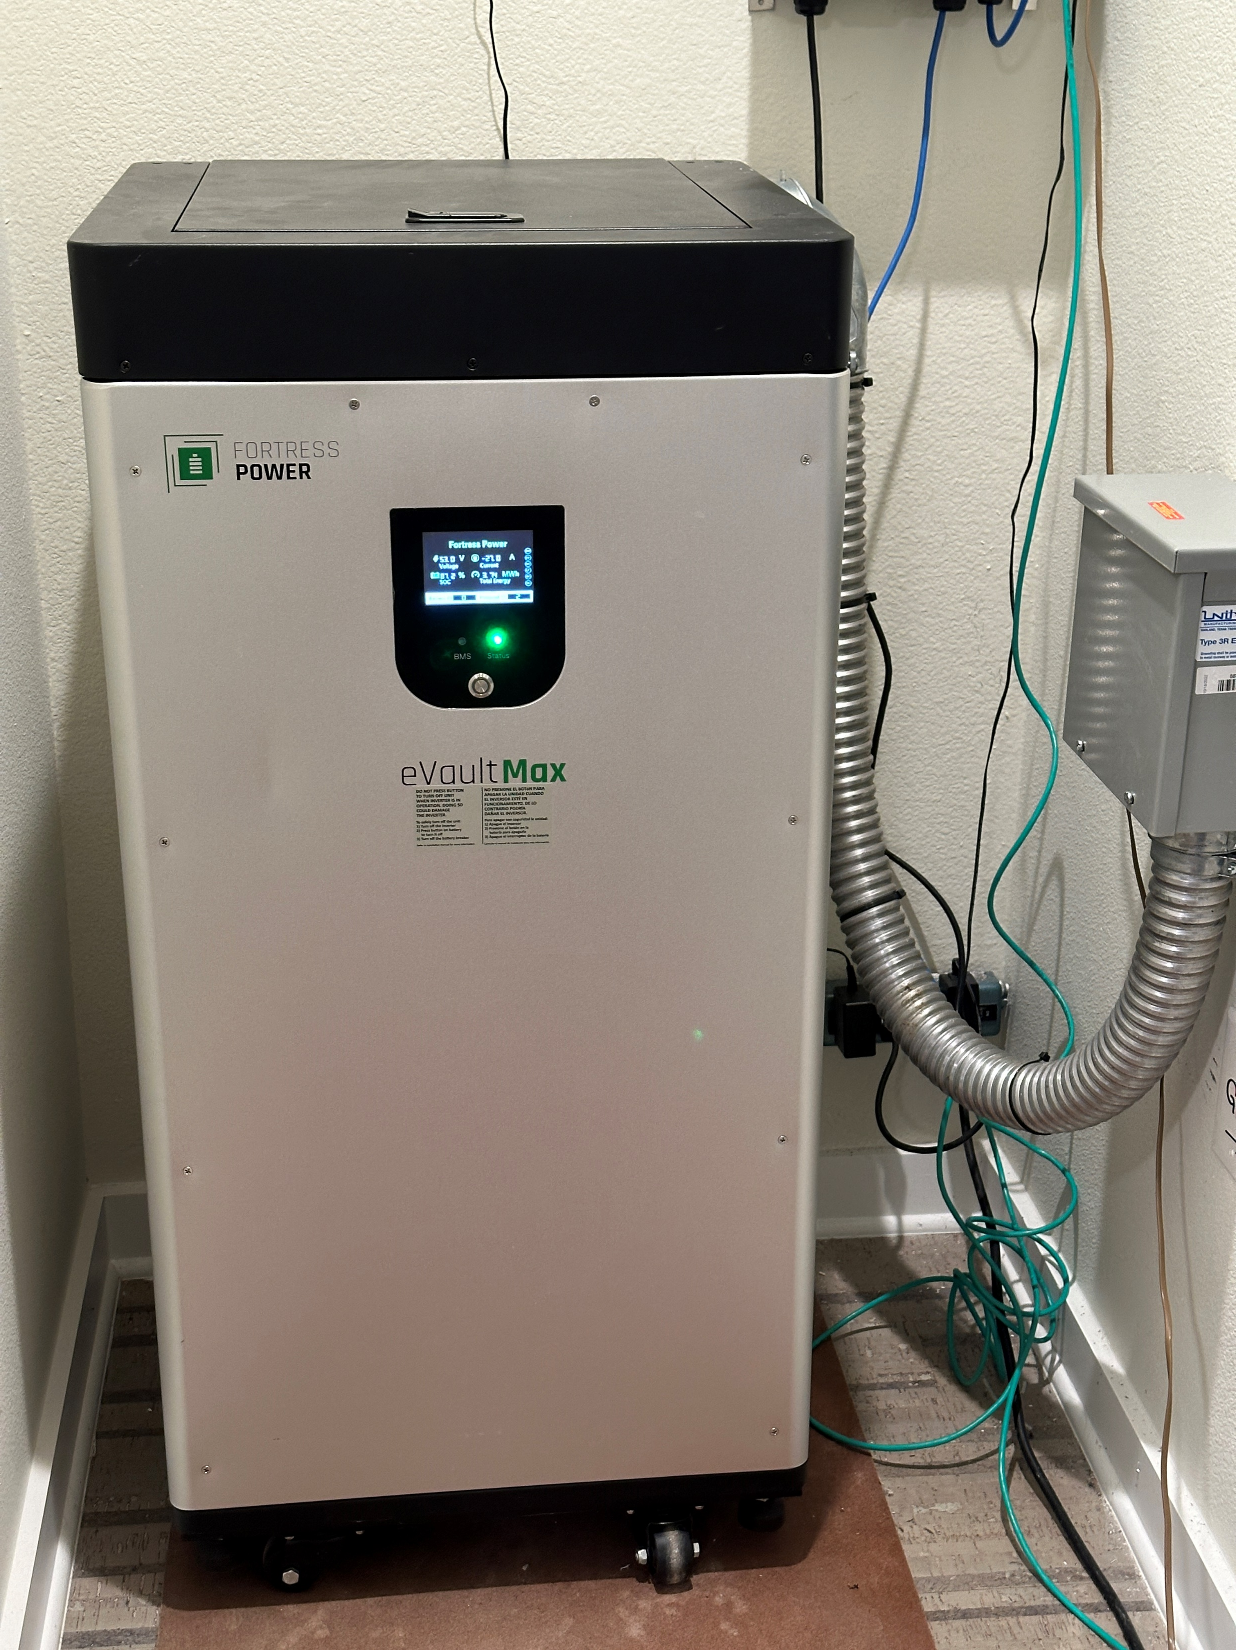
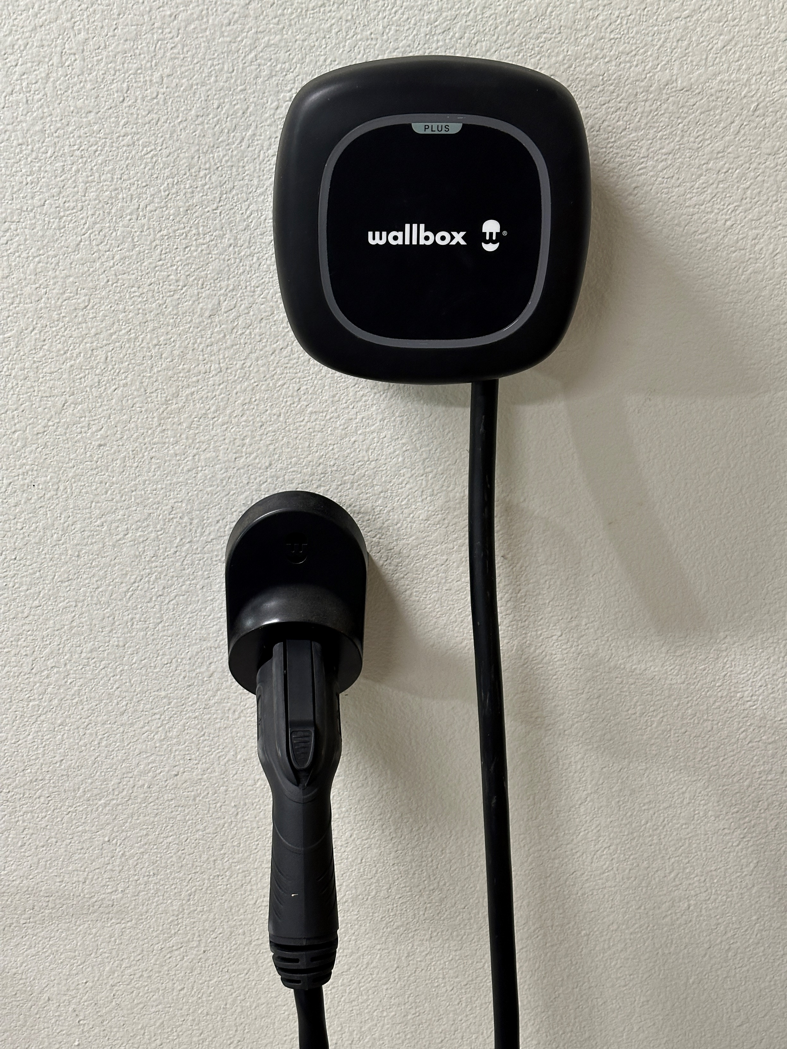
Byrom House Overview by Bill Byrom (Irving TX)

Slide 3
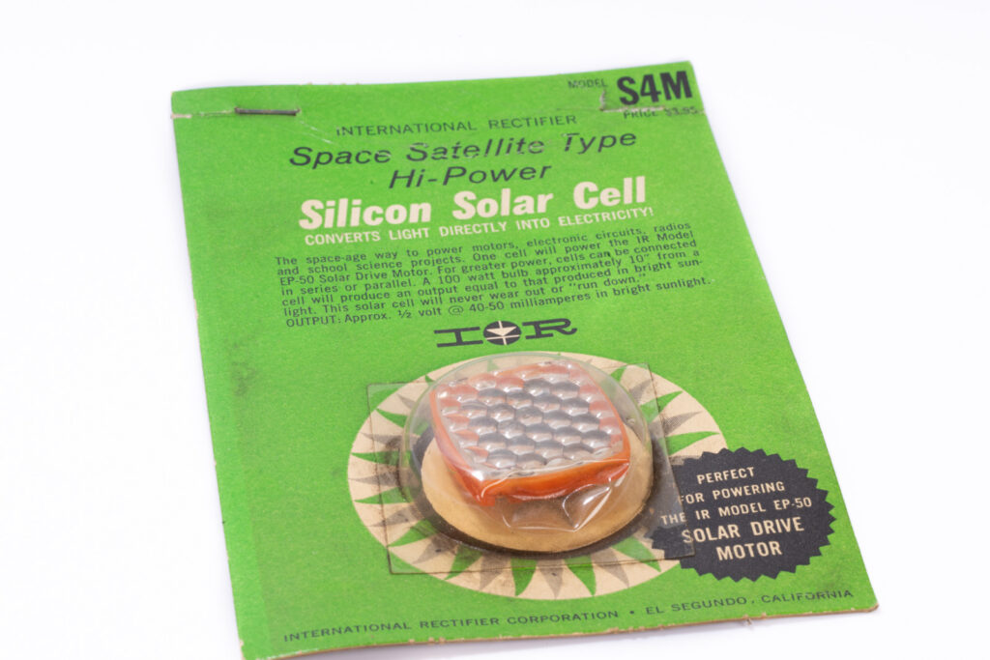
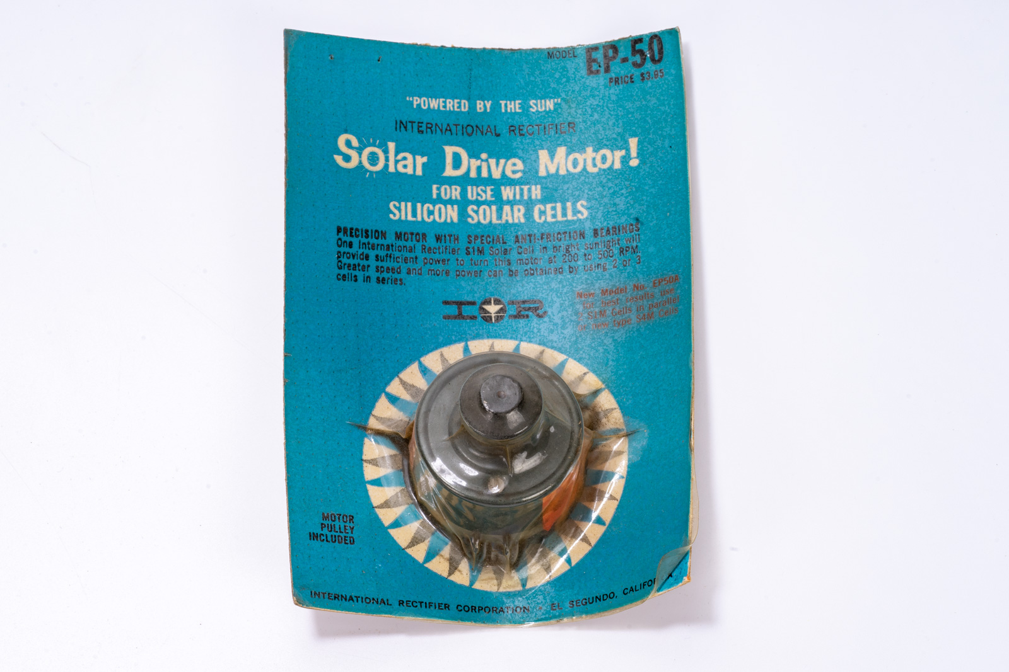
Early Solar Cells
My first solar cell was an Internattional Rectifier model S4M, which I used while I was an elementary school student 60 years ago (about 1965). I also owned an EP-50 small DC motor which spun rapidly when powerd by the solar cell in direct sunlight. Some of the first solar cells were used to power satellites.

Slide 4
Energy Use Affects the Quality of Life
Energy is expensive – improving efficiency can help your budget
Human health and comfort require both heating and cooling of our homes and vehicles in our North Texas climate
Air pollution due to energy use in our homes and vehicles can lead to discomfort and medical issues such as allergies and cardiovascular disease
The location of the air pollution can be inside the home, local emissions from a vehicle tailpipe, when refilling a fossil fueled vehicle at a gas station, or outside in the general environment
Some home HVAC systems and autos can generate noise pollution
Global warming & other societal issues are directly affected by energy use

Slide 5
Ozone Air Pollution in North Texas
Dallas Morning News (2025): Long ozone season starts up in DFW. Increase in pollutant raises air quality concern for many until November. By MIRIAM FAUZIA, Staff Writer. Ozone season is upon North Texas, meaning air quality will be top of mind for some residents. The season — which marks the window when there’s a greater risk of harmful amounts of ground-level ozone — is actually the majority of the year in Dallas-Fort Worth, lasting from March 1 to November 30.
Ozone is a gas formed in the atmosphere when three atoms of oxygen combine, according to the Texas Commission on Environmental Quality.
While overall air quality has improved over the past few decades, ozone levels continue to exceed federal standards.

Slide 6
Building Energy Efficiency
HVAC heating and cooling of buildings depends on isolating the indoor environment from the outdoor environment
One important area where energy can be wasted is air leakage around door and window gaskets as well as other locations
Energy can also leak directly through windows and doors
Quality insulation of the building envelope is also important, including walls, ceilings, roofs, and flooring
Many technologies with varying efficiencies are available for heating and cooling the air inside a building – more on this later

Slide 7
Energy Use in a Home
The greatest use of energy in a house is usually the HVAC and water heating systems
But appliances also use a significant amount of energy. These include a refrigerator, oven, range top, dishwasher, washing machine, and clothes dryer. Televisions and other electronic devices can also use a significant amount of energy if they are left on for many hours.
Lighting and fans also consume quite a bit of energy, especially if used for long periods. LED lighting is much better than incandescent.
Natural gas appliances burn methane and release air pollution and greenhouse gases. Trace gases such as benzine are also released.

Slide 8
Sources Of Energy For Home Use (grid/local)
Electric grid supplied renewable energy (solar, wind, hydroelectric)
Electric grid supplied nuclear energy
Electric grid supplied fossil fueled energy (methane gas, coal, oil)
District or co-generation energy (not available in most areas)
Natural gas via pipes (methane) and oil in some northern states
Local home solar panels (and batteries)
Vehicle to house transfer from electric vehicle (coming soon!)
Heating or electric generator using methane, propane, or gasoline

Slide 9
Renewable vs Non-Renewable
Energy Sources
Renewable energy sources (solar, wind, and hydroelectric) are essentially non-polluting and rely on energy provided in our current era from the sun
Non-Renewable fossil energy sources (methane, oil, propane) normally require burning of fuels which were created using energy from the sun in previous eras, producing air and often other pollution, including greenhouse gases
Nuclear energy is technically non-renewable, but does not produce air pollution. But it does produce radioactive waste and thermal (heat) pollution

Slide 10
Renewable Energy Supplied From The Grid
In most areas of North Texas you can purchase electricity produced by solar farms and/or wind farms
Solar farms are photovoltaic (PV) solar power plants. Light from the sun directly produces electric power using solar cells mounted on panels. Large solar farms are usually in areas with fewer clouds and moderate to low land cost.
Wind farms are in areas which tend to receive a lot of wind, often at night. These are often found in areas west and northwest of North Texas, as well as in Oklahoma.
Hydroelectric power is not prevalent in North Texas.

Slide 11
Home Solar Power Systems
Solar panels can be mounted on a roof, carport, or a ground mount
Power is usually generated only when the solar panel receives direct sunlight illumination. Some solar panels are bifacial and can also generate power from the rear of the panel.
Batteries are often added to the system for use at night.
The output of a solar panel has a negative temperature coefficient. For example, heating a solar panel by 18 degrees F (10 degrees C) might reduce the power output by 3.4%.
The output is greatest when sunlight falls normal to the panel surface. So the output varies through the day and during different seasons.

Slide 12
Byrom Net Zero House in Irving TX
This house was built by owner Bill Byrom between 2020-2023. I bought the 30 year old house on this corner in 1994 and lived in it until I decided to replace it with a new custom energy efficient house without foundation, plumbing, and electrical wiring problems.
I moved into the new house in April, 2023. The solar power system was activated in September, 2023.
This is a Zero Energy Building (ZEB). Energy cost is zero (about $11.33 per month average credit and no monthly energy bill any month since system activation).
The house is all-electric with no natural gas connection.

Slide 13
Features of this house
All-electric zero energy building (ZEB)
Solar power system
  14.4 kW DC: 36 X 400 W solar panels (Q.Peak DUO BLK ML-G10)
  Tigo TS4-A-O optimizers for each solar panel (provides quick disconnect)
  Sol-Ark 15K system inverter (this is the heart of the solar power system)
  Fortress Power Vault Max 18.5 kWh LiFePO4 ESS storage battery
Wallbox Pulsar Plus Level 2 EV charger (mfg in Arlington, TX)
  Installed to support 40 A (9.6 kW) maximum charge rate at 240 VAC
Energy efficient double pane windows with insulated motorized window shades for all except two small windows

Slide 14
Additional House Features
Ground source heat pump HVAC and water heating system
  Six 275 ft deep geothermal boreholes were drilled in the back yard
  Water circulates in underground tubing through these boreholes
  A refrigerant-based heat pump in the attic transfers heat between the house and the large underground rock volume beneath the back yard
  This is the most efficient HVAC system available, with a SEER rating of 56
Attention during construction to full insulation of all walls and attic areas
Noise reducing wallboard material on lower level to reduce sound transfer
Low VOC materials, including natural cork water resistant flooring

Slide 15
More House Features
Raised seam metal roof (rainfall runoff feeds drip irrigation system)
Large elevator and circular staircase for second level access
App-controlled smart house features
  LED room lighting, vent fans, and room fans with additional LED lights
  Motorized remotely controllable exterior door locks (3 doors)
  HVAC system control and monitoring
  Exterior garage overhead door remotely controlled with cameras
  Sol-Ark and Tigo remote control and monitoring of solar power system

Slide 16
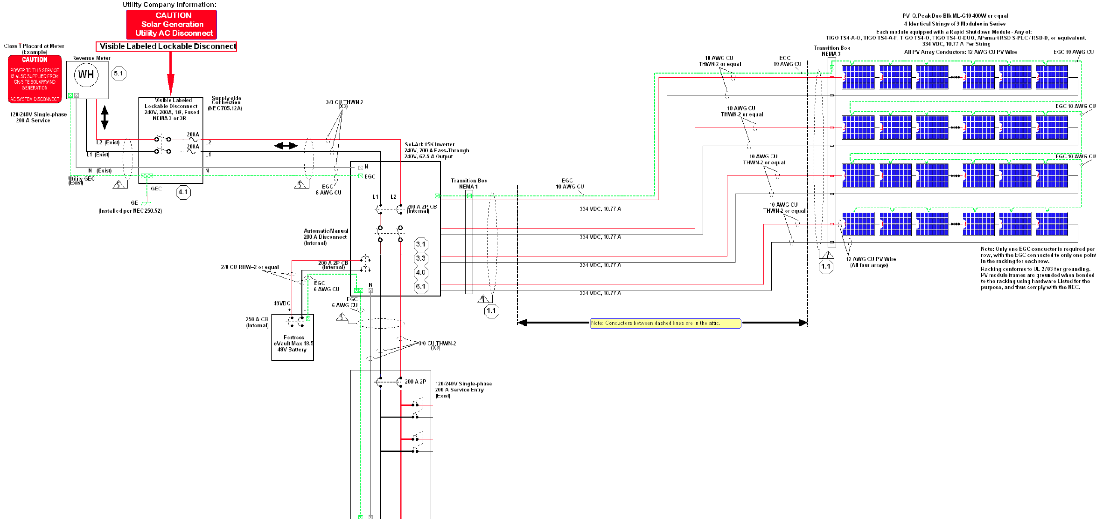
Solar Power System

Slide 17
Operation of the Solar Power System
PV (photovoltaic) power from the 36 solar panels can be used to advantage in several ways:
  If the house load (including EV charging) is higher than the PV output, the solar power reduces the import (purchase) of grid energy. Small systems with only a few solar panels can significantly reduce their energy expense. This is true even if the system is not set up to sell energy to the grid.
  If the PV output exceeds the house load and the system is set up for bidirectional metering, the system can sell power to the grid. Unfortunately, current REP plans typically pay much less for grid export than for import.
  If the system has a large ESS (Energy Storage System) battery, the house may be able to operate all (or most) of the night using the battery, then recharge the following day. This is called load shifting and can reduce your bill.

Slide 18
Zero Energy Building (ZEB) Definition
A zero energy building (ZEB) produces enough renewable energy to meet its own annual energy consumption requirements, thereby reducing the use of non-renewable energy in the building sector.
ZEBs use all cost-effective measures to reduce energy usage through energy efficiency and include renewable energy systems that produce enough energy to meet remaining energy needs.
There are a number of long-term advantages of moving toward ZEBs, including lower environmental impacts, lower operating and maintenance costs, better resiliency to power outages and natural disasters, and improved energy security.
Reducing building energy consumption in new building construction or renovation can be accomplished through various means, including integrated design, energy efficiency retrofits, reduced plug loads and energy conservation programs. Reduced energy consumption makes it simpler and less expensive to meet the building’s energy needs with renewable sources of energy.
Source: “A Common Definition for Zero Energy Buildings” prepared for the US Department of Energy by the National Institute of Building Sciences

Slide 19
Effect of Solar Power System on Electric Bill
My REP (Retail Electric Provider) is Green Mountain Energy (GME). I have a solar buy-back plan. Here are details of my particular multi-year plan:
Import from grid: $0.10307/kWh + ~$0.0558/kWh Oncor delivery charge
Export to grid: -$0.05307/kWh per month
Taxes and fixed service fee
Note that the Oncor delivery charge and taxes can significantly increase the cost of energy imported from the grid (purchased). The effective cost of importing energy is about 3X what I receive by exporting my solar energy to the grid through GME.
In real world conditions, I need to import a little each day to make it easy to run my system during very cold or very hot weather when my ESS battery can’t keep the HVAC and other loads running all night.

Slide 20
Byrom House Solar System Results
Conditioned area: 3,143 sq ft all-electric building with natural gas consumption of 0 therms (no gas or propane service to house)
2025 house + EV charging electrical load: 11,303 kWh
2025 solar power system PV production (AC): 22,800 kWh
2025 grid electrical power import (purchase from grid): 2,118 kWh
2025 grid electrical power export (sell to grid): 11,861 kWh
2025 net export sales to grid (export - import) surplus: 9,743 kWh
2025 discharge from ESS storage battery (load shifting): 3,612 kWh
Total net energy since system was activated in Sept 2023: Under Zero
(no monthly bill was due and about $136 accumulated credit per year).

Slide 21
Sun Angle Effect on Solar Power System
The Earth’s axis is tilted at about 23.5 degrees to our solar orbit, producing differing maximum (local noon) sun angles to the horizon through the year at our latitude of 32.8 degrees north:
  57.2 degrees sun height at vernal (March 20) and autumnal (Sept 22) equinox
  33.8 degrees sun height at winter (Dec 21) solstice
  80.6 degrees sun height at summer (June 20) solstice
My south-facing roof (containing solar panels) is angled at 30 degrees, producing maximum output at a sun height of (90-30)=60 degrees. This is close to optimum for our latitude. The roof faces directly south and the power output follows a modified cosine curve each day.
The maximum power from the solar panels should be near the equinoxes, when the peak sunlight is directly orthogonal to the panels. Energy production during the summer is increased due to the long days, but the panel output is reduced by 0.34% per degree C. The output in the winter is reduced due to shorter days. Thick clouds reduce the output significantly.

Slide 22
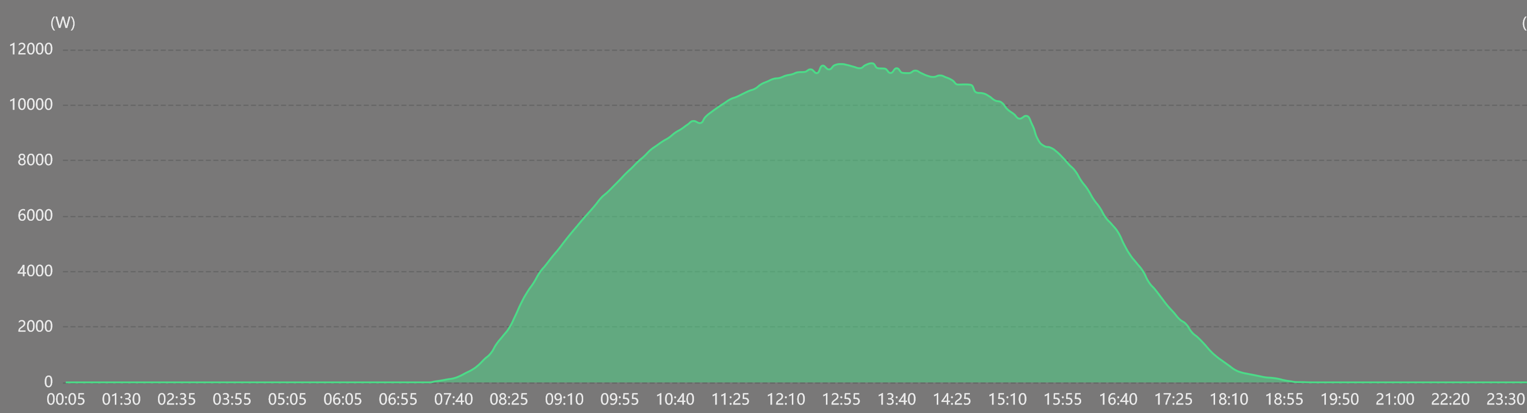
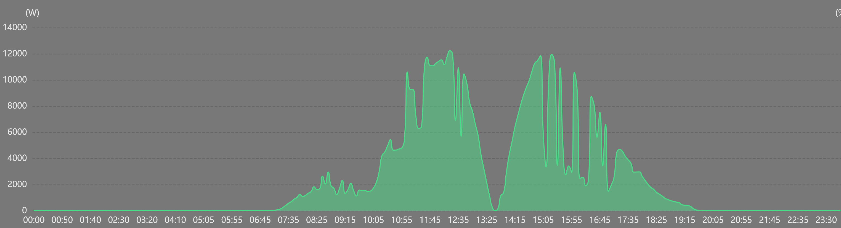
PV Generation on Clear and Cloudy Days
Wed Oct 1, 2024
Mon April 8, 2024

Slide 23
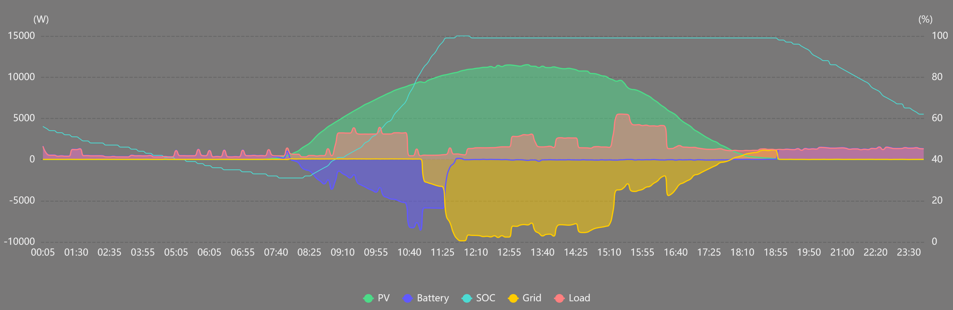
Load Shifting Using ESS Battery
My Fortress Power ESS battery can power my house for most or all of the night (depending on temperature and appliance use). The Sol-Ark system inverter is programmed to favor battery use at night. As soon as the sun rises the next morning, the battery is recharged (usually by noon). Energy is exported (sold to the grid) each afternoon and only a small amount of energy is imported (purchased from the grid) before sunup and around sundown.

Slide 24
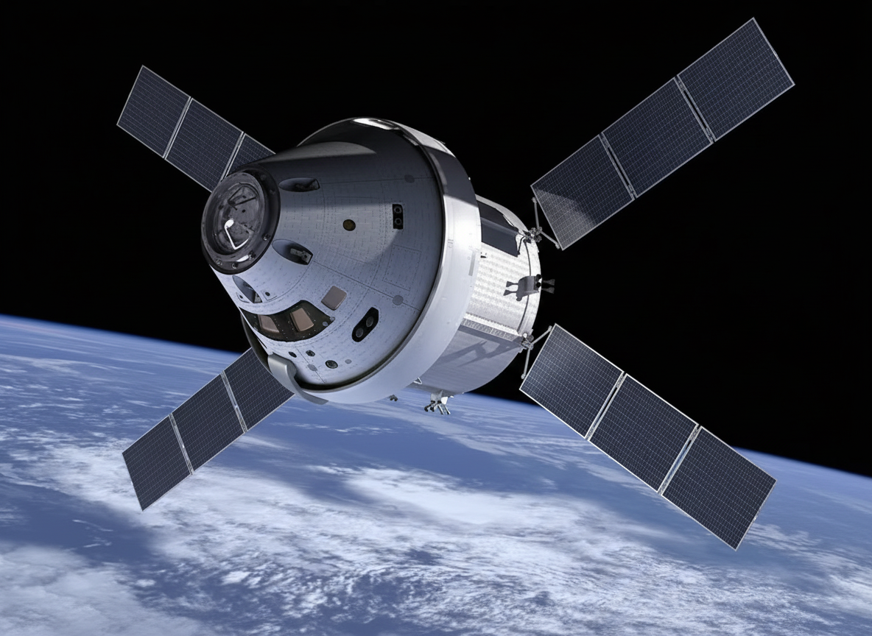
Comparison with
Artemis II Spacecraft
The European Service Module supplies power to the Orion capsule
Four movable solar panel wings (each 7 meters long)
Total mean DC output in daylight: 10.5 kW
Spacecraft effective daily generation: 180 kWh/day
Byrom house average daily generation: 62.5 kWh

Slide 25
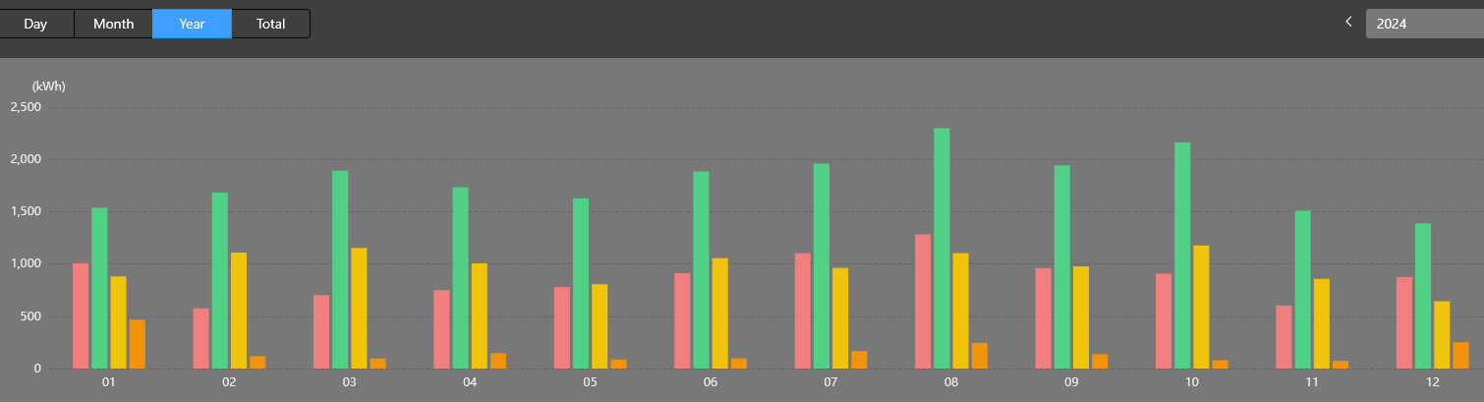
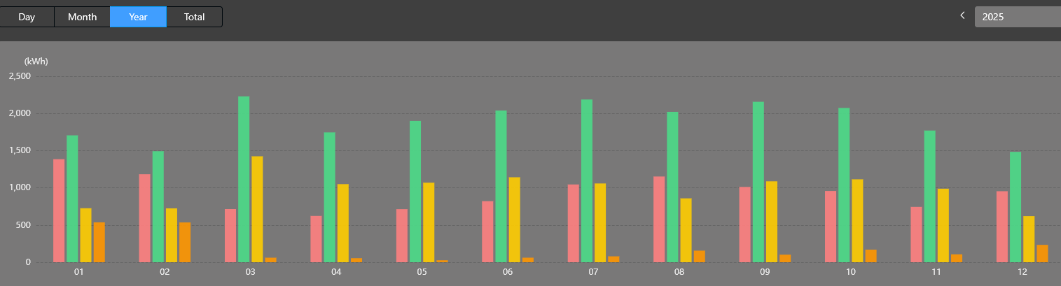
Solar System History 2024/2025
Red: PV generation
Green: PV generation
Yellow: Export to grid
Orange: Import from grid

Slide 26
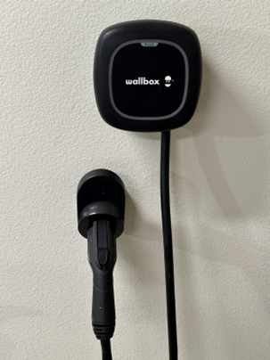
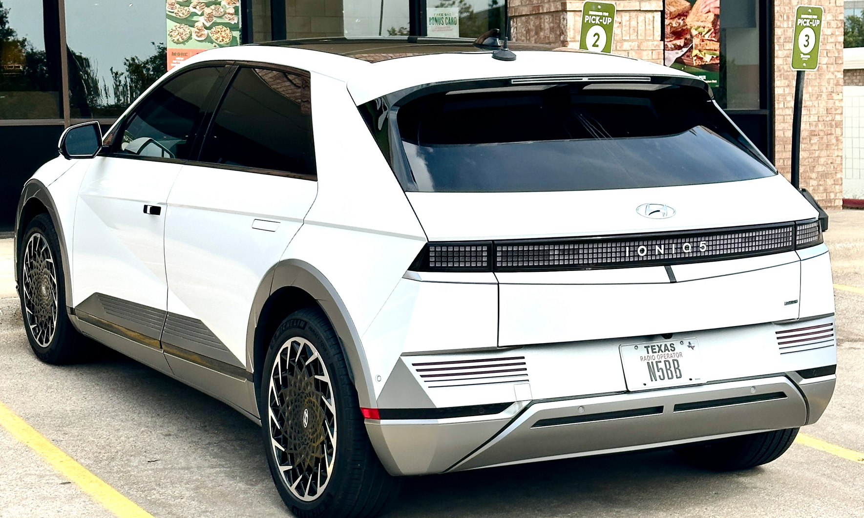
Hyundai IONIQ 5 EV with Wallbox charger
AWD (dual motor, four wheel drive) full electric SUV
Original EV battery and power train warranty: 10 years / 100,000 mi
Battery: 77.4 kWh (about 230 mile range)
Typical around town mileage: ~ 3 mi/kWh (330 wH/mi)
Charge rate with Wallbox level 2 charger (set to 40 A max at 240 VAC):
@6A (1.44 kW) >> 30 min / 1% charge level
@10A (2.4 kW) >> 20 min / 1% charge level
@20A (4.8 kW) >> 10 min / 1% charge level
@40A (9.6 kW) >> 5 min / 1% charge level
Charge time from 20% to 80% SOC: ~5 hours @40A
Vehicle can be charged using 120/240 VAC (level 2)
or fast DC charging

Slide 27
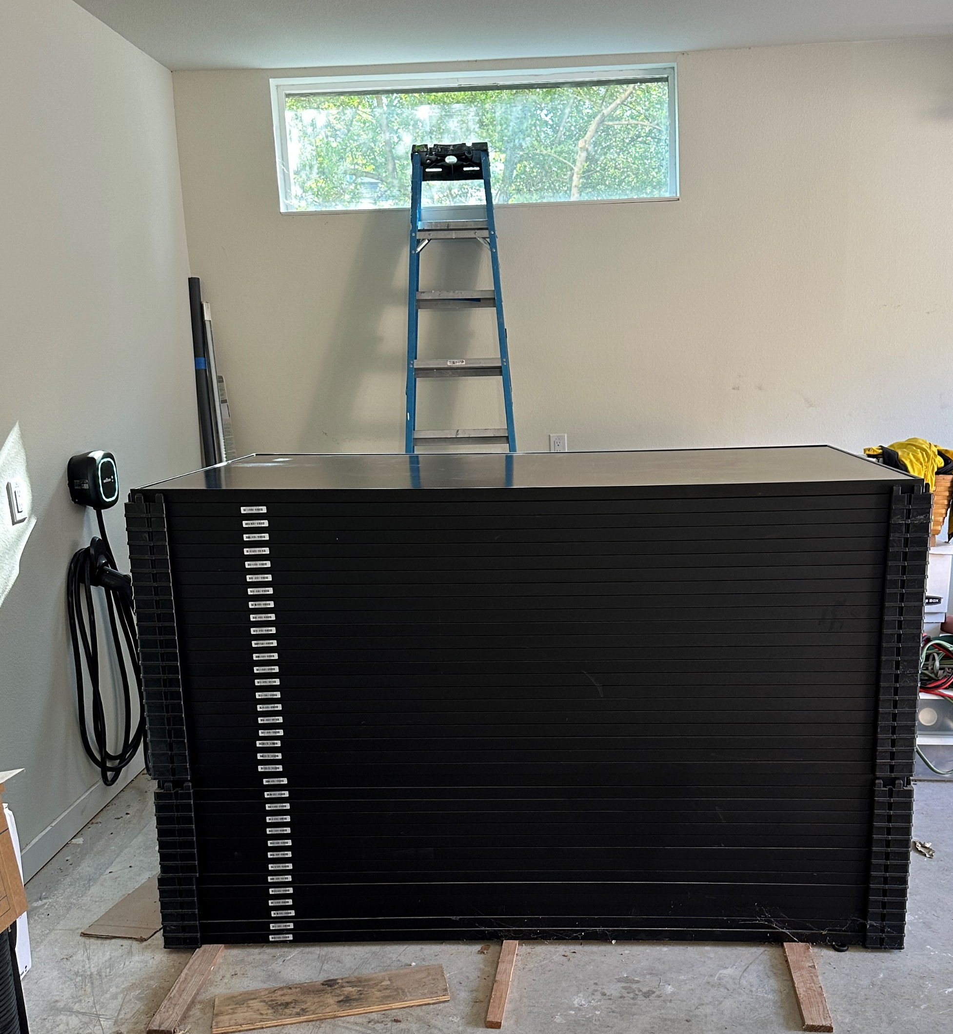
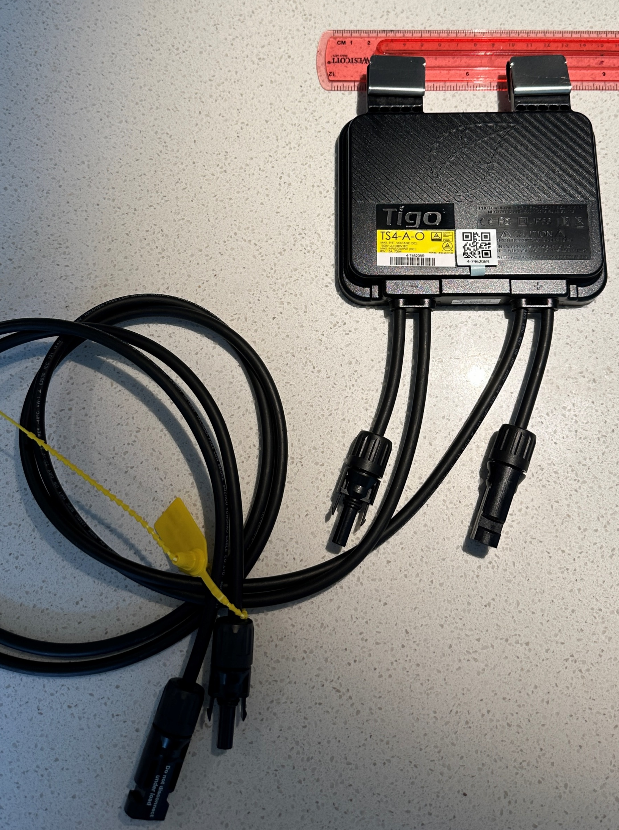
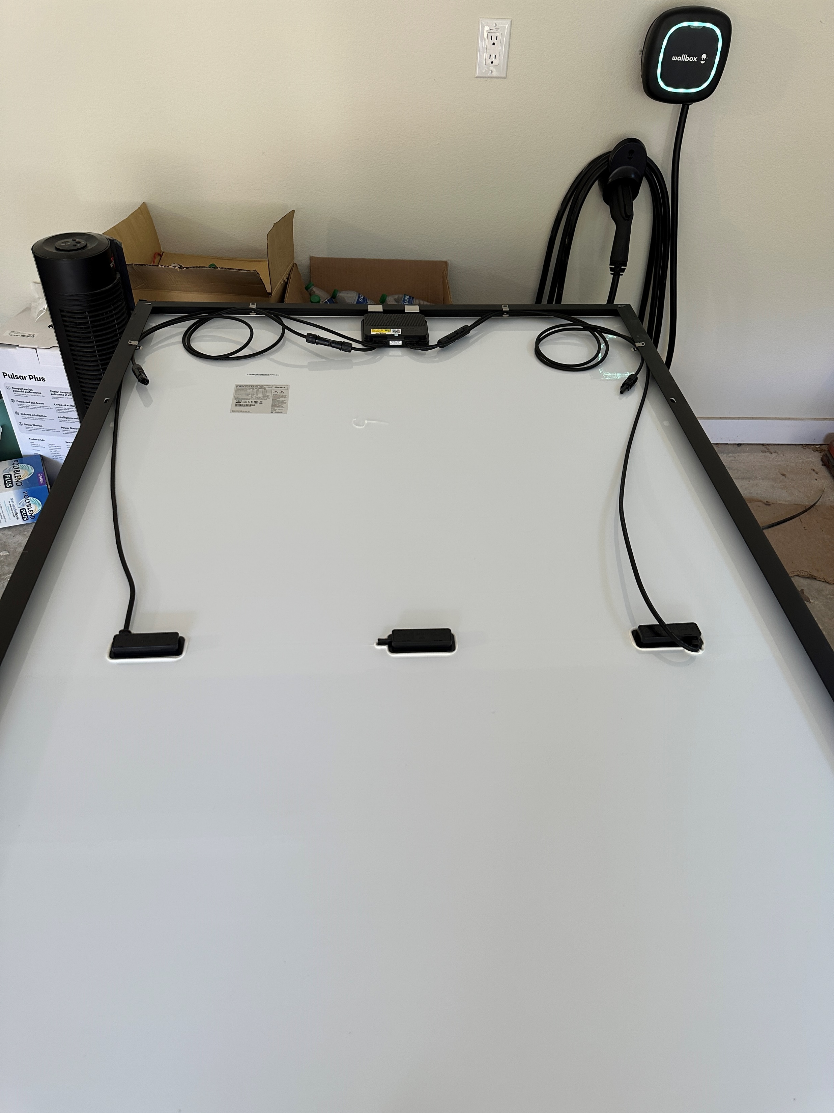

Slide 28
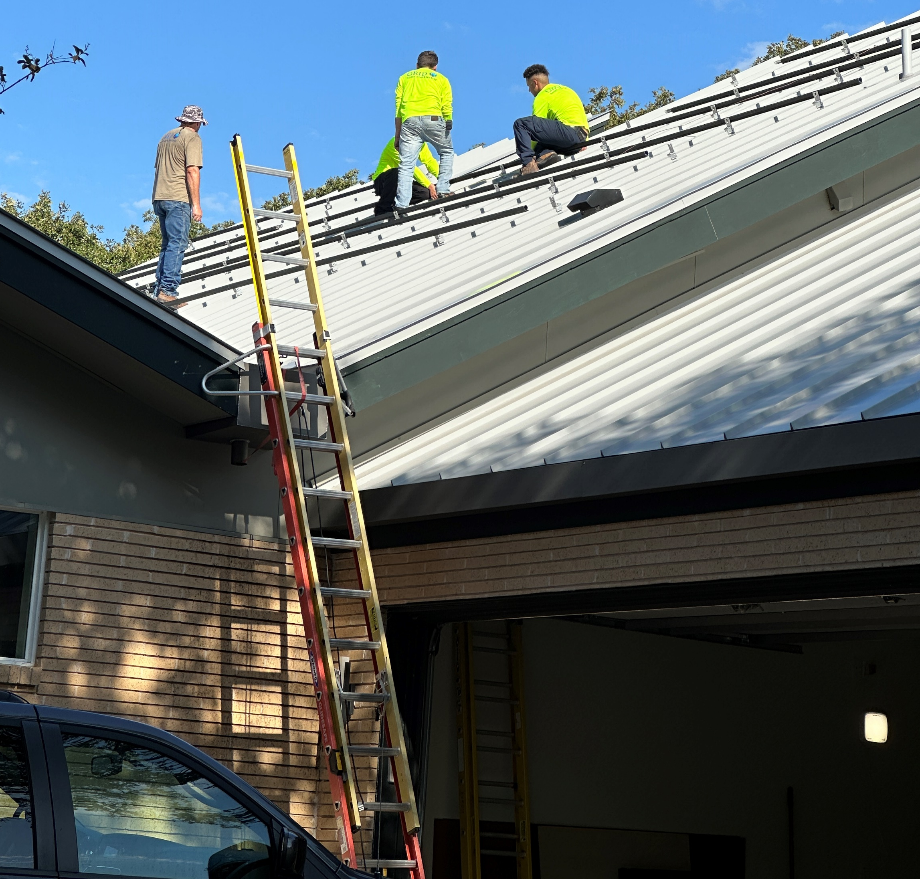
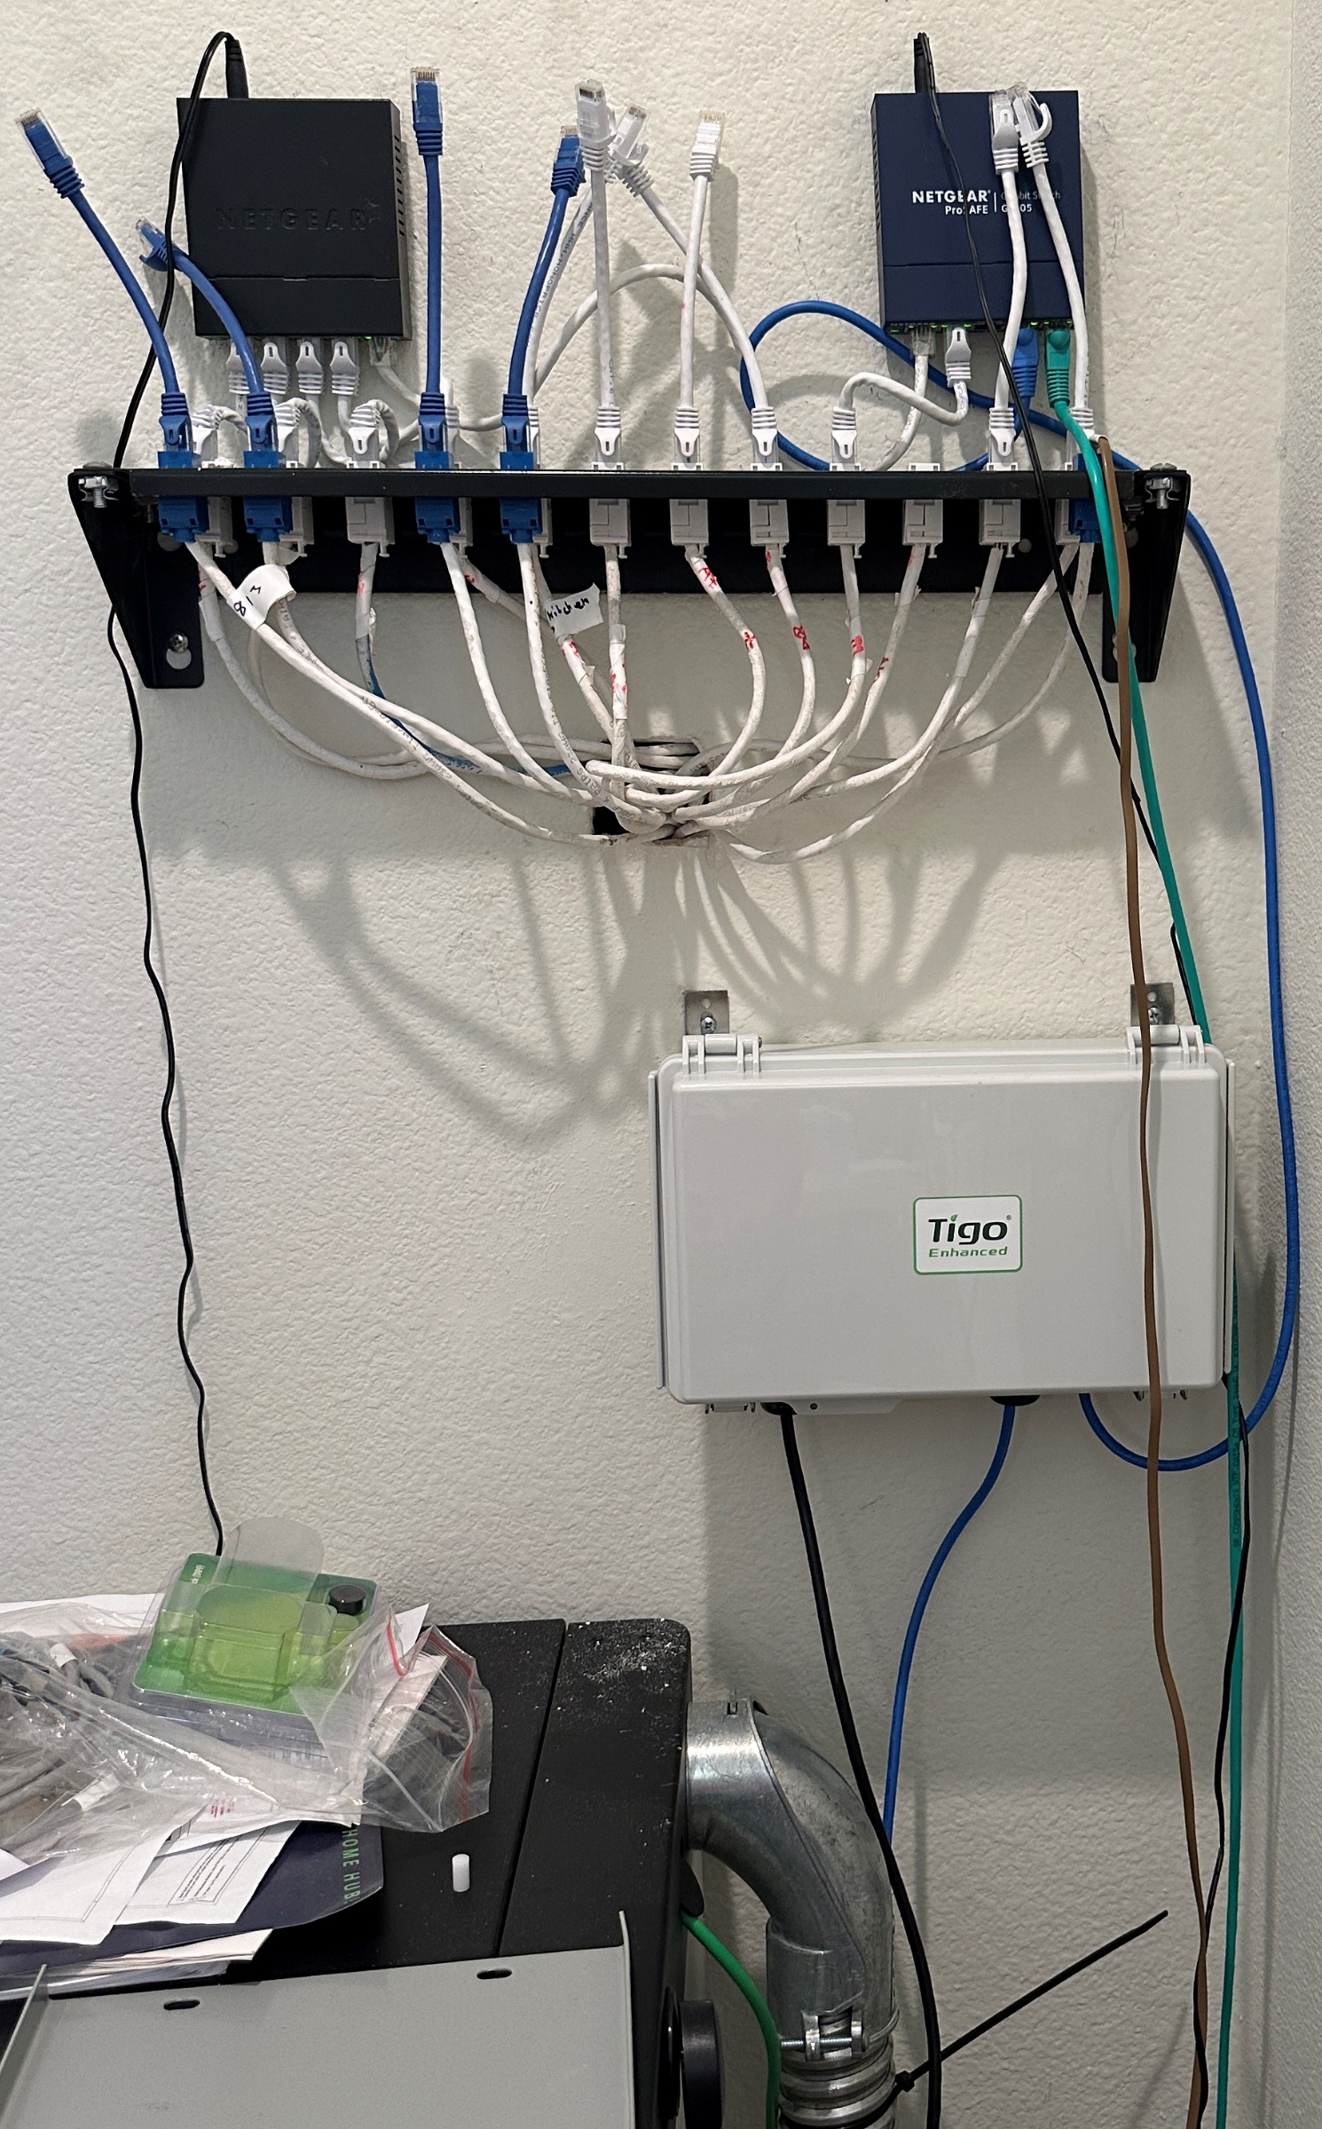
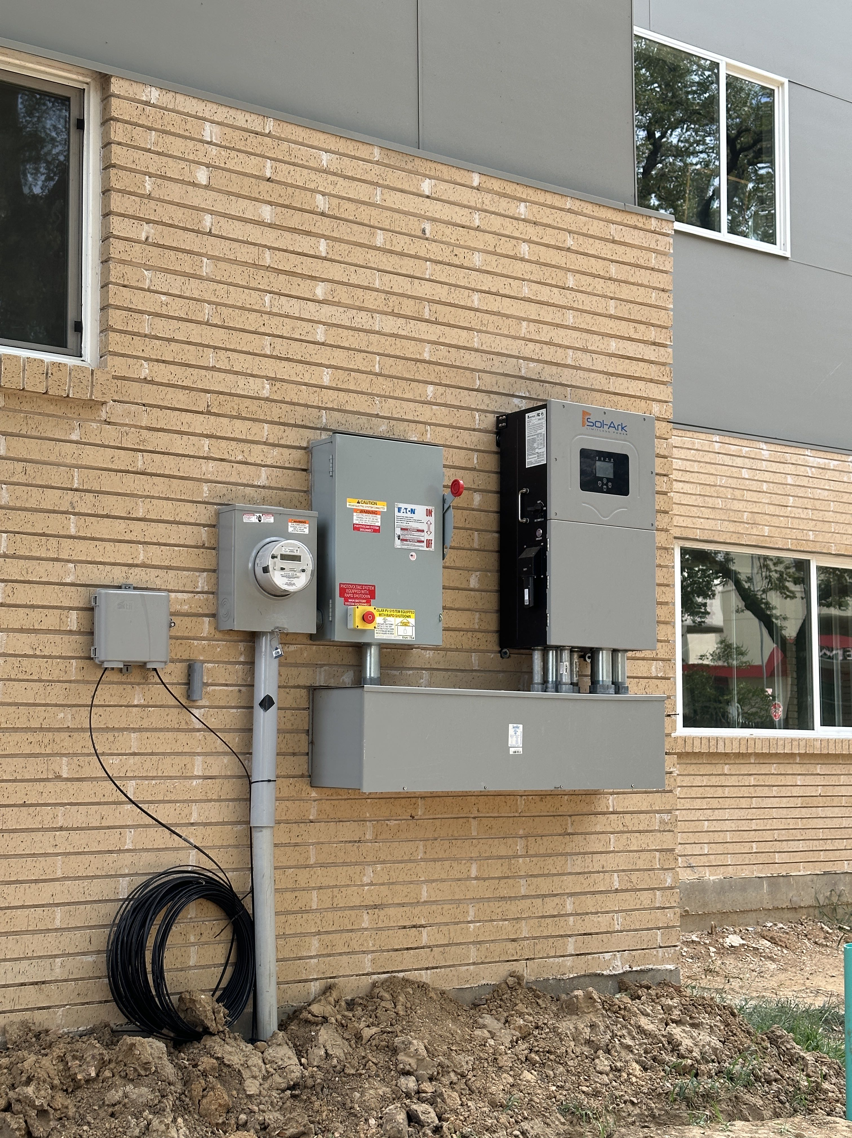

Slide 29
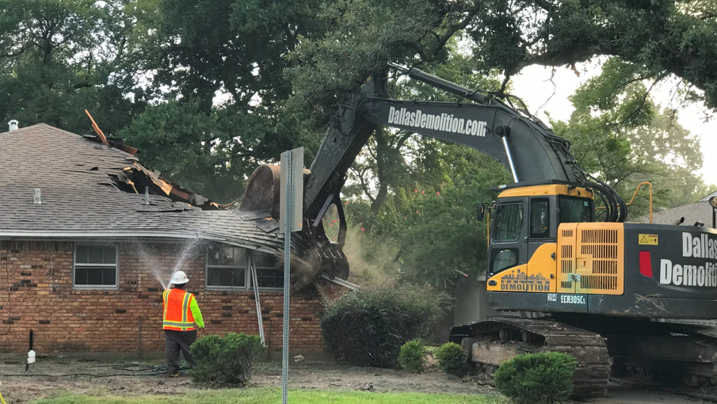
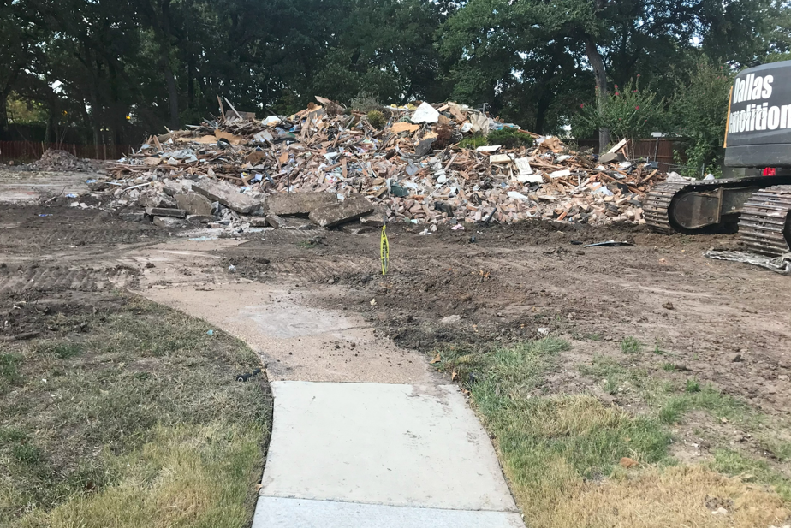

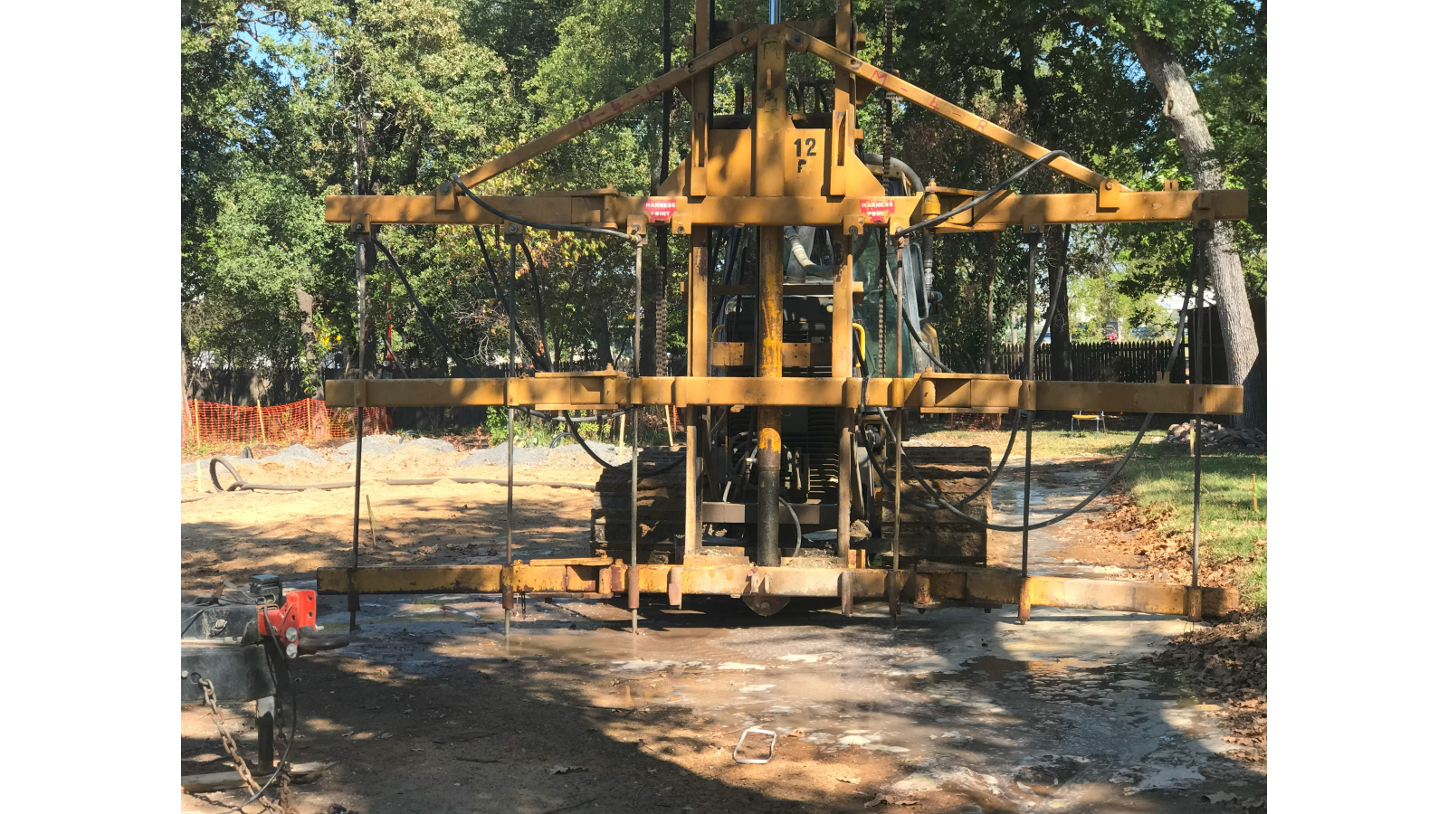

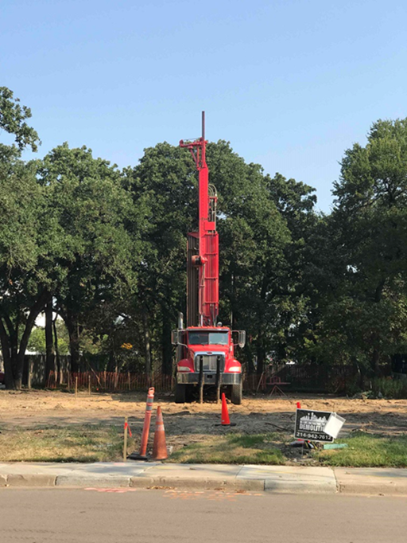
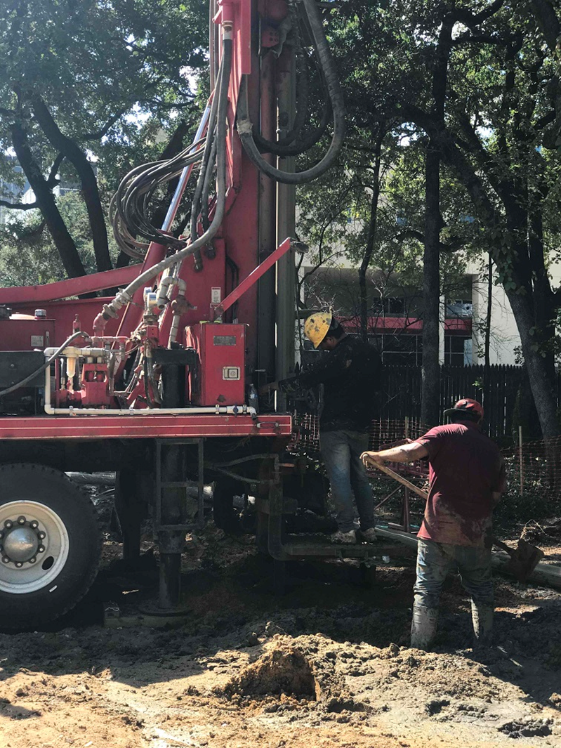
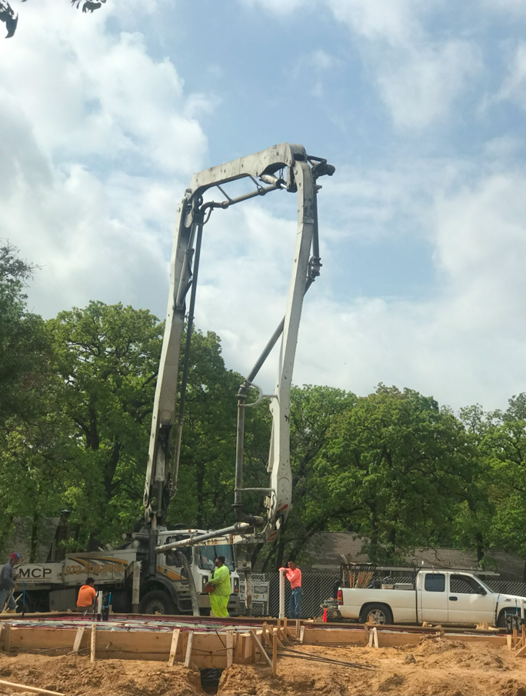

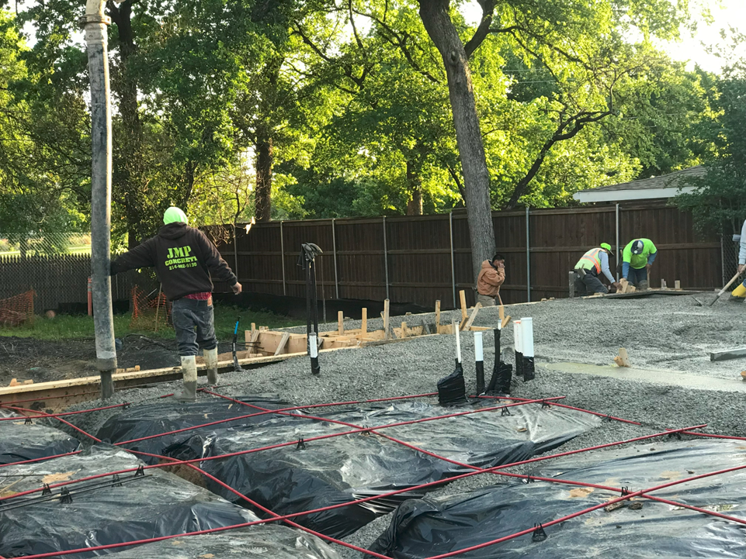
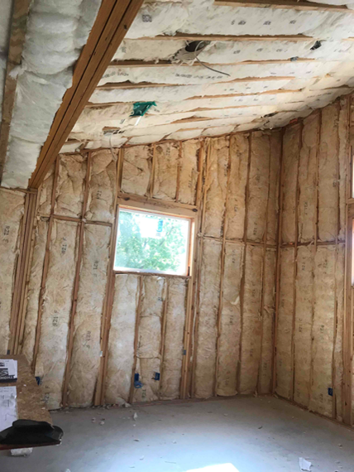
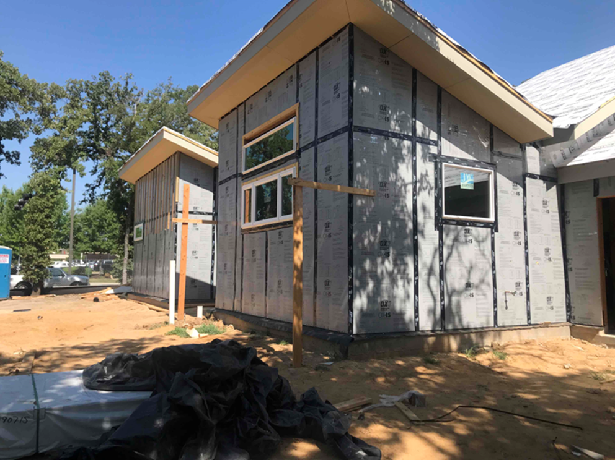
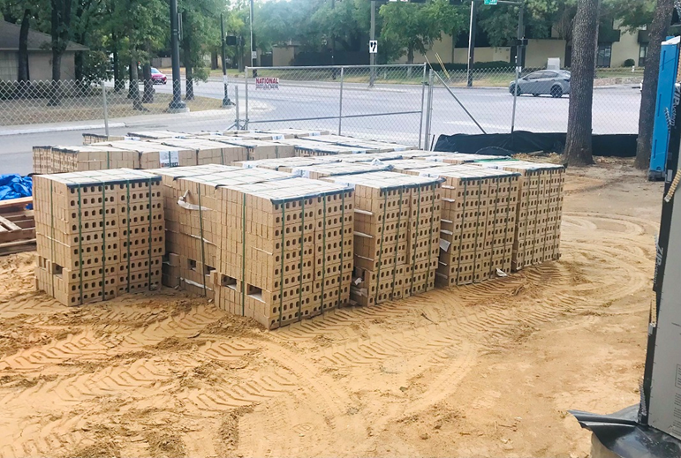

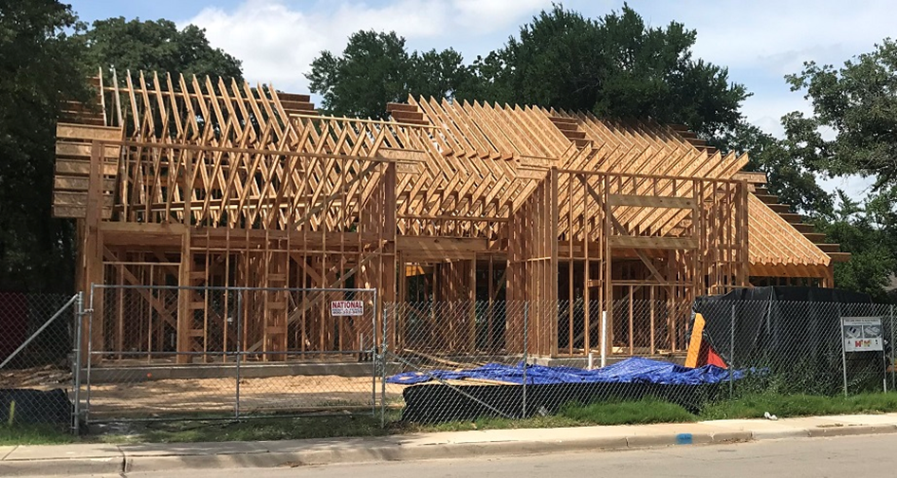
Demolition & New House Construction Photos

