Slide 1

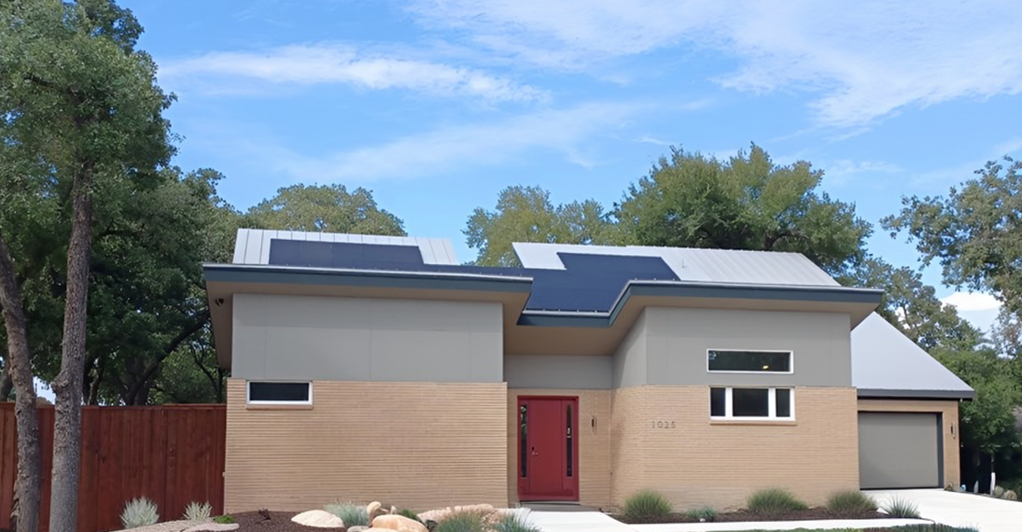
The Byrom House in Irving, TX
Tour dates: October 2-3-4, 2026
solar@byrom.net --- North Texas Clean Energy Group

Slide 2
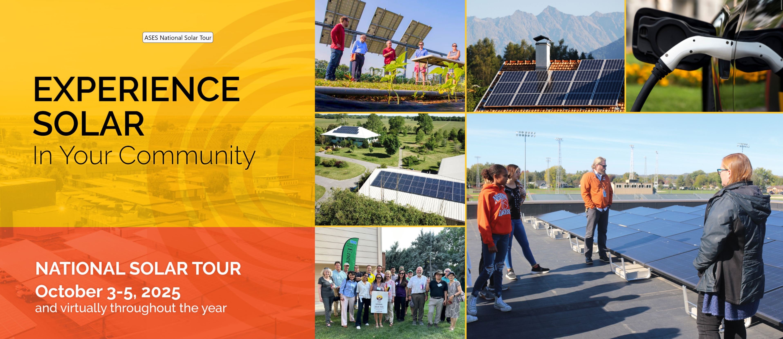
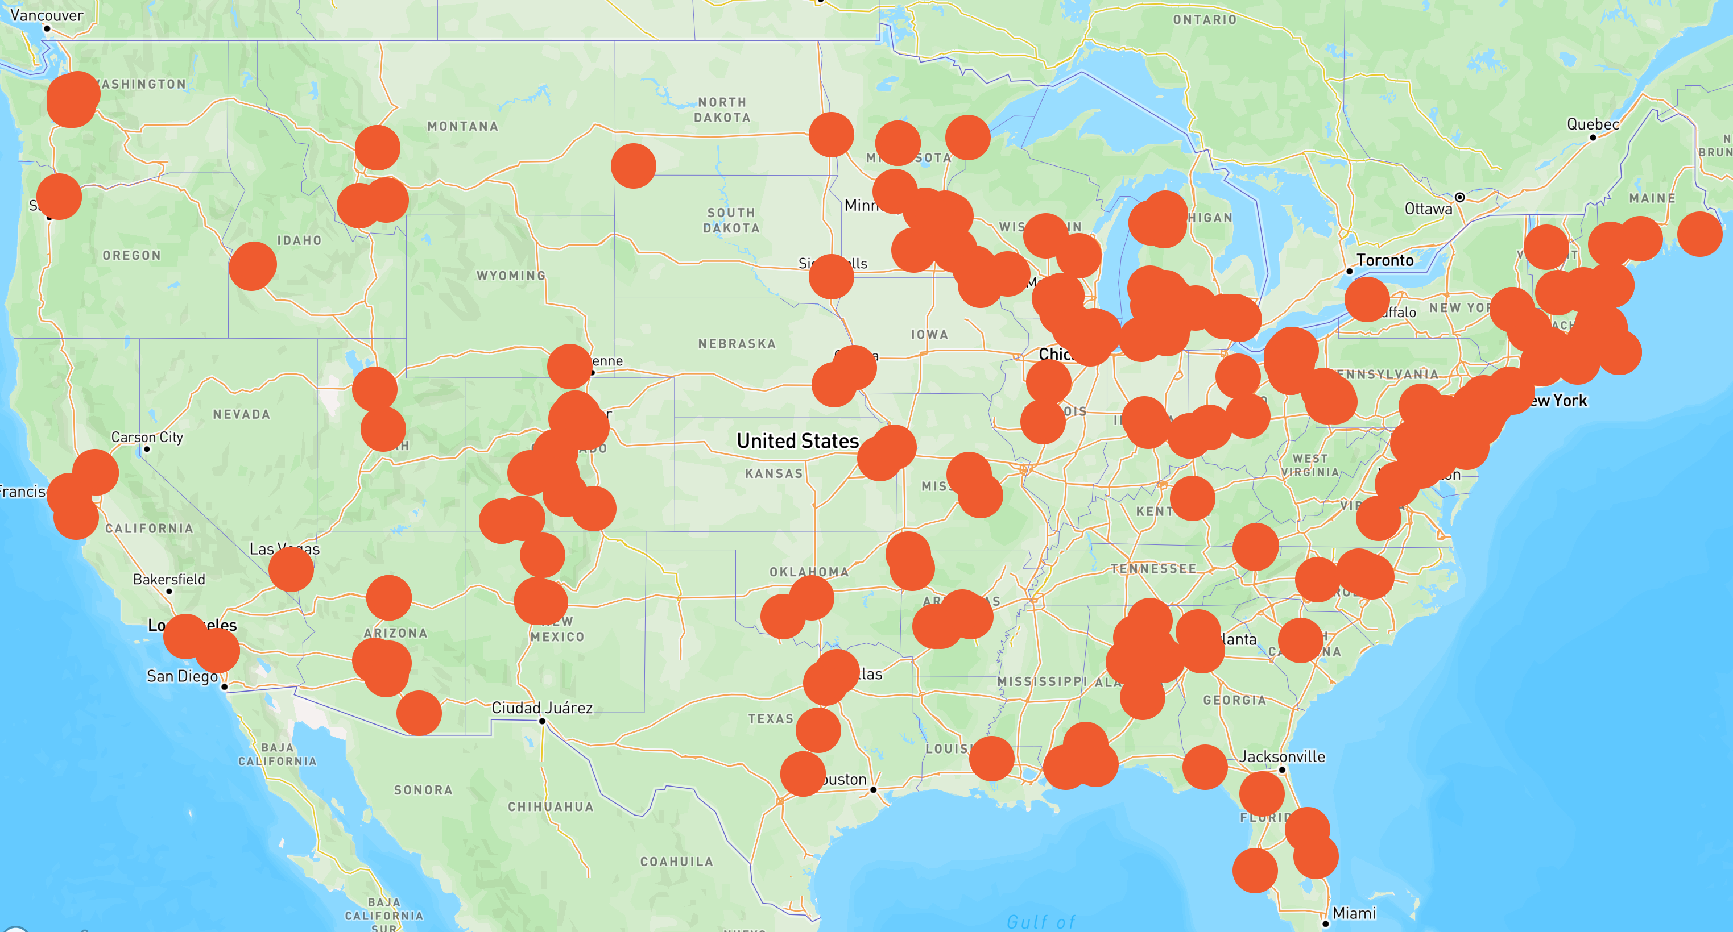
National Solar Tour
Largest Grassroots Solar and Sustainable Living Event in the Nation
Showcase Weekend: October 2-4, 2026
In-Person and Virtually Across the Nation Throughout the Year
Hosted by the American Solar Energy Society (ASES), the purpose of the National Solar Tour is to promote renewable energy awareness and increase the adoption of solar energy.
Celebrating its 30th anniversary this year, the National Solar Tour centers around neighborhood discussions about solar, recommendations on installers, financing, local laws, and other considerations and hesitations around installing solar panels, purchasing electric vehicles, and installing energy efficiency upgrades.

Slide 3
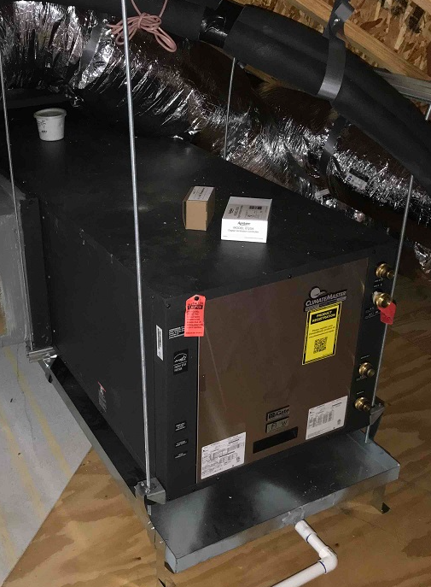
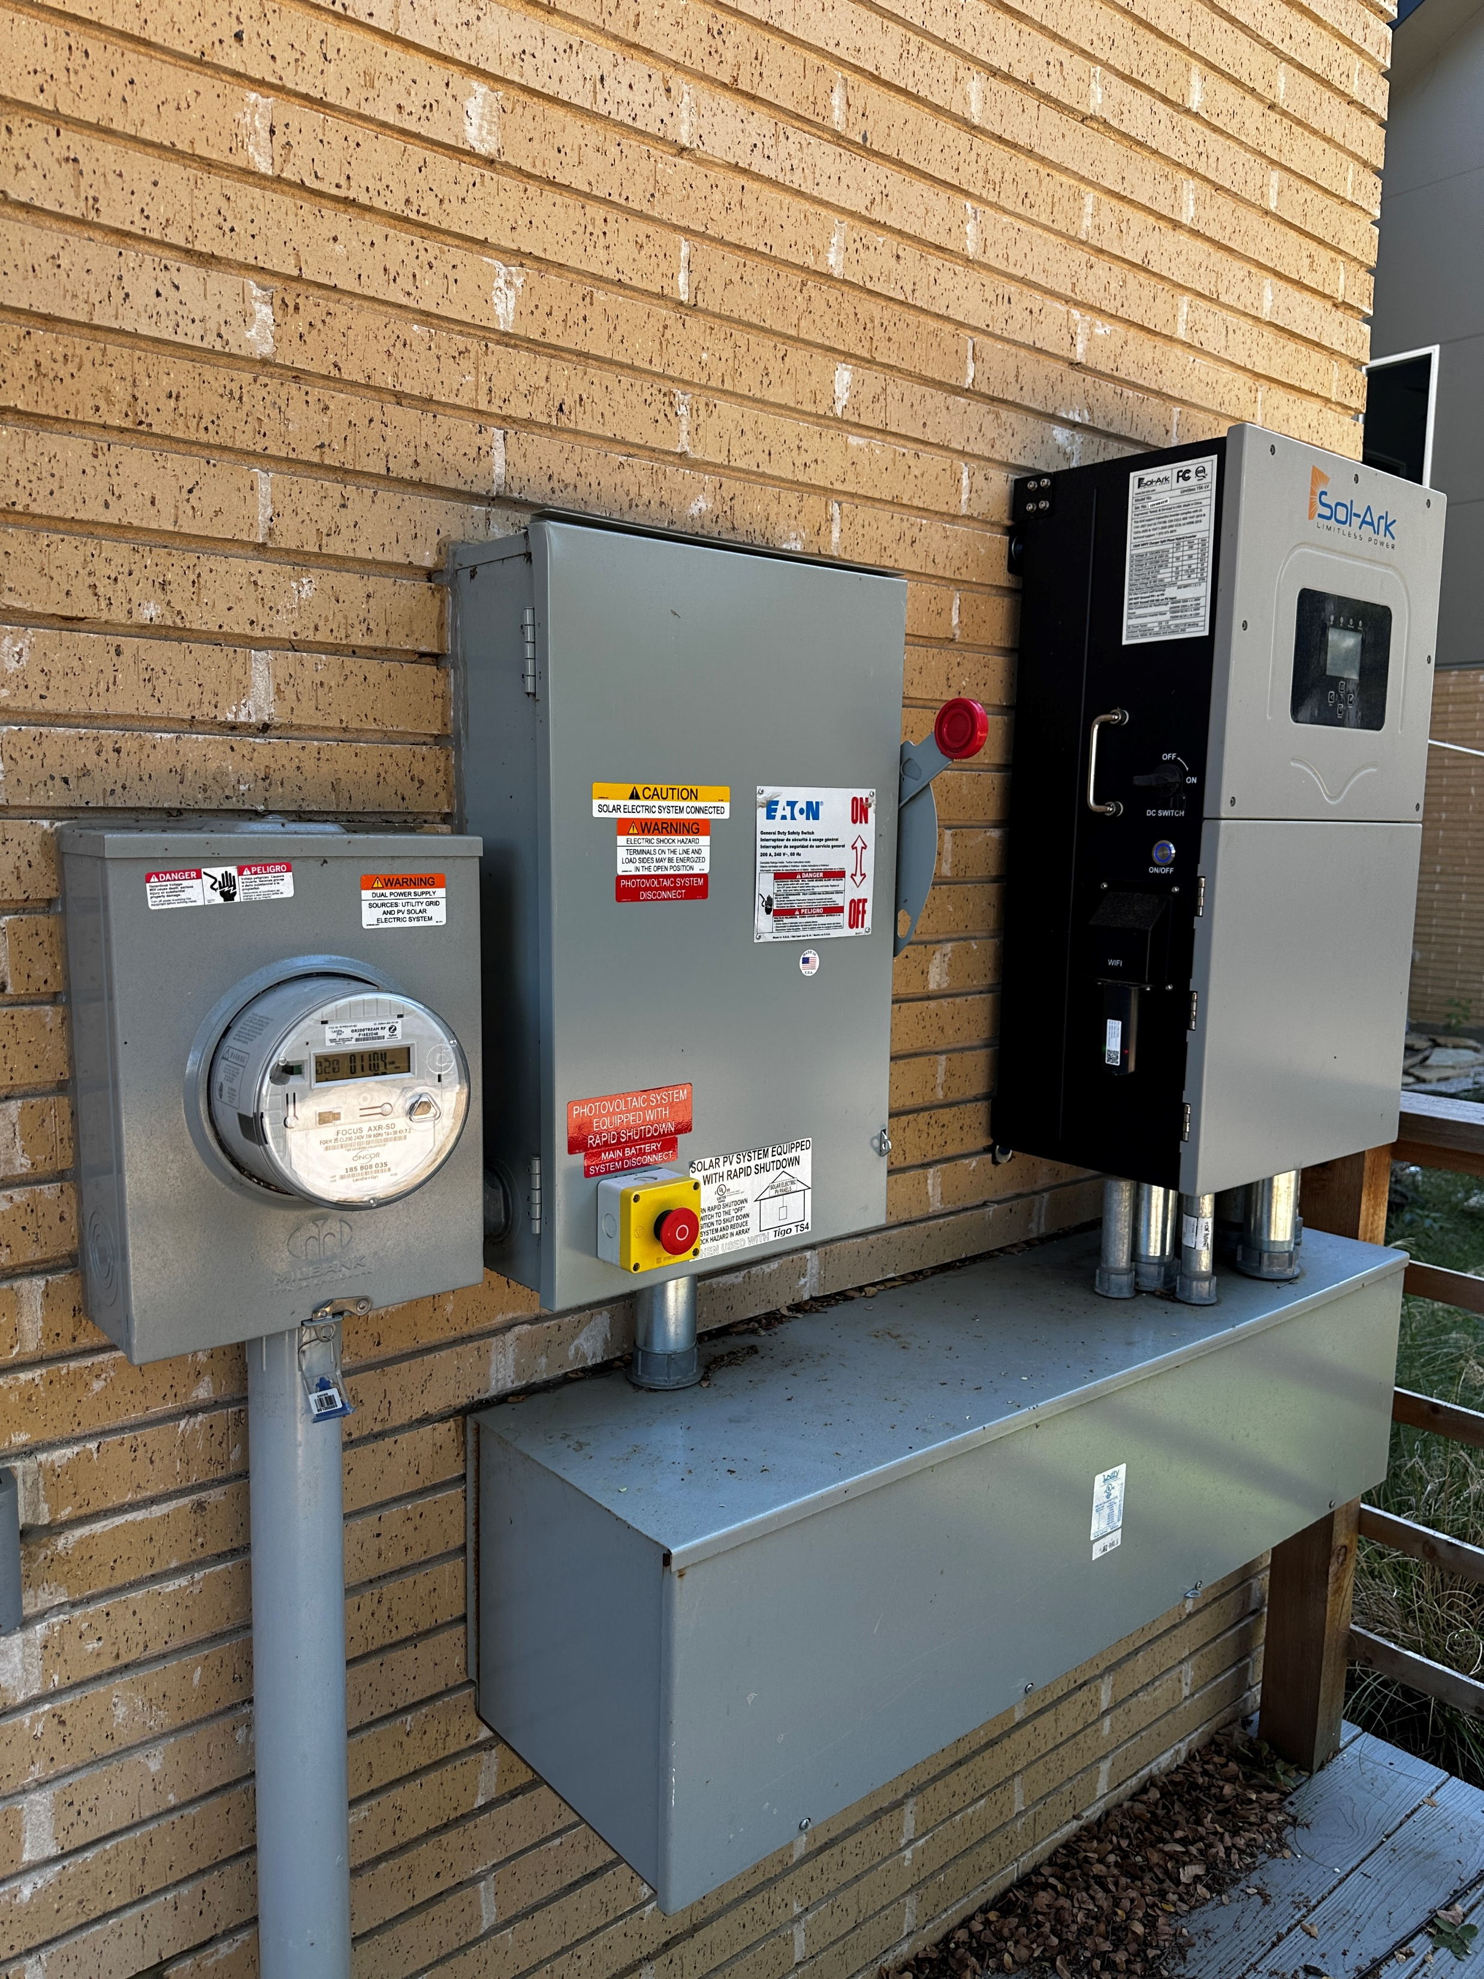
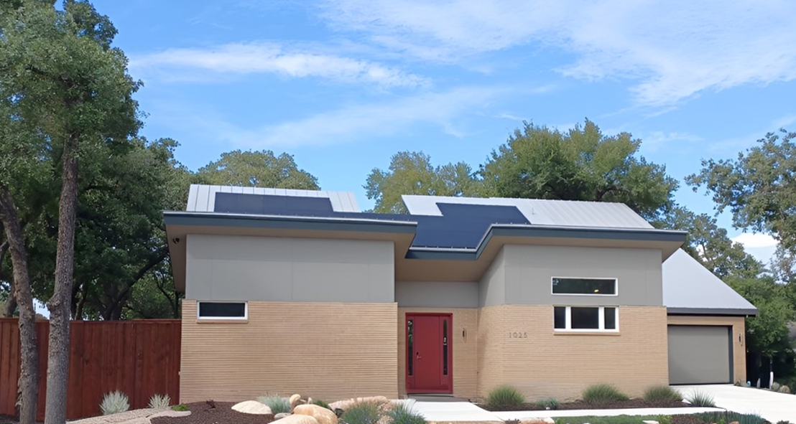
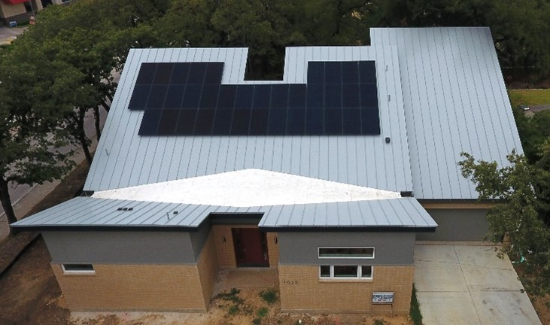
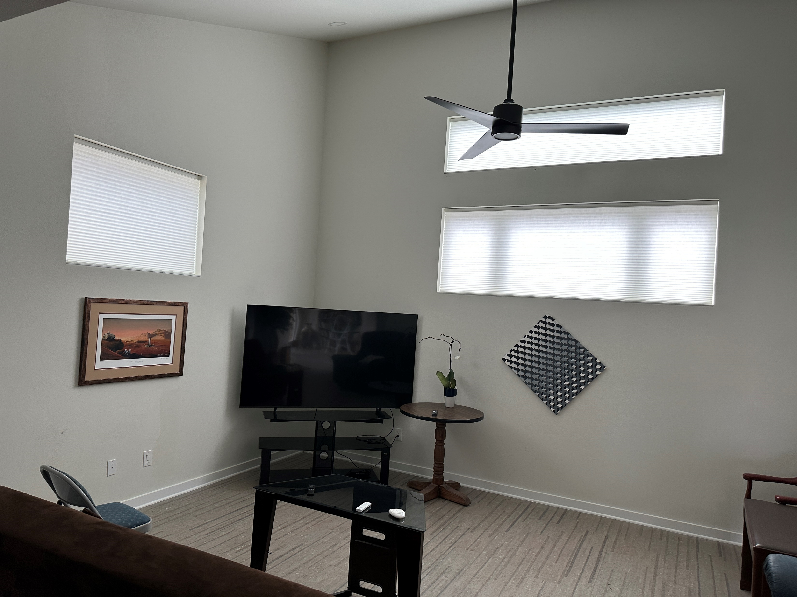
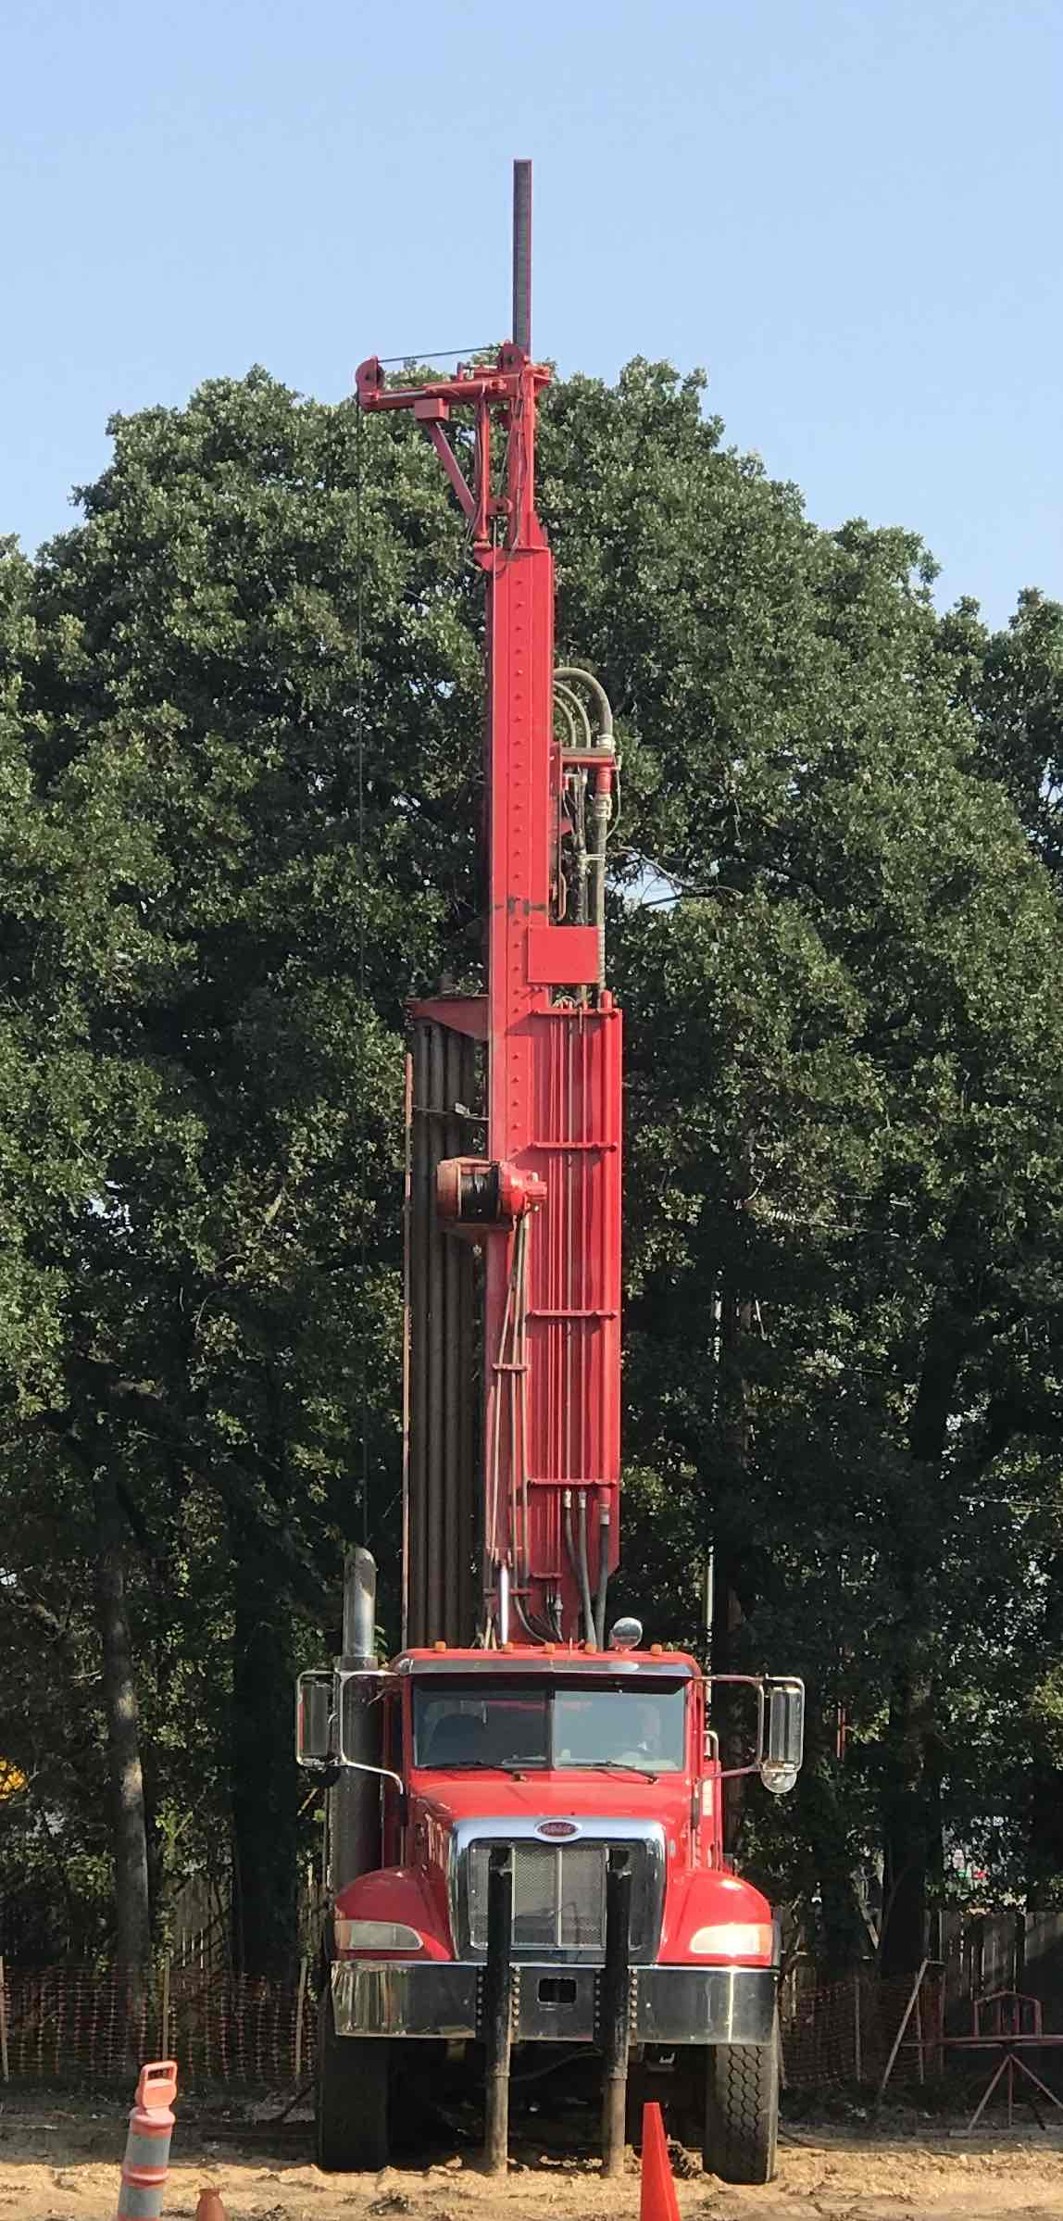

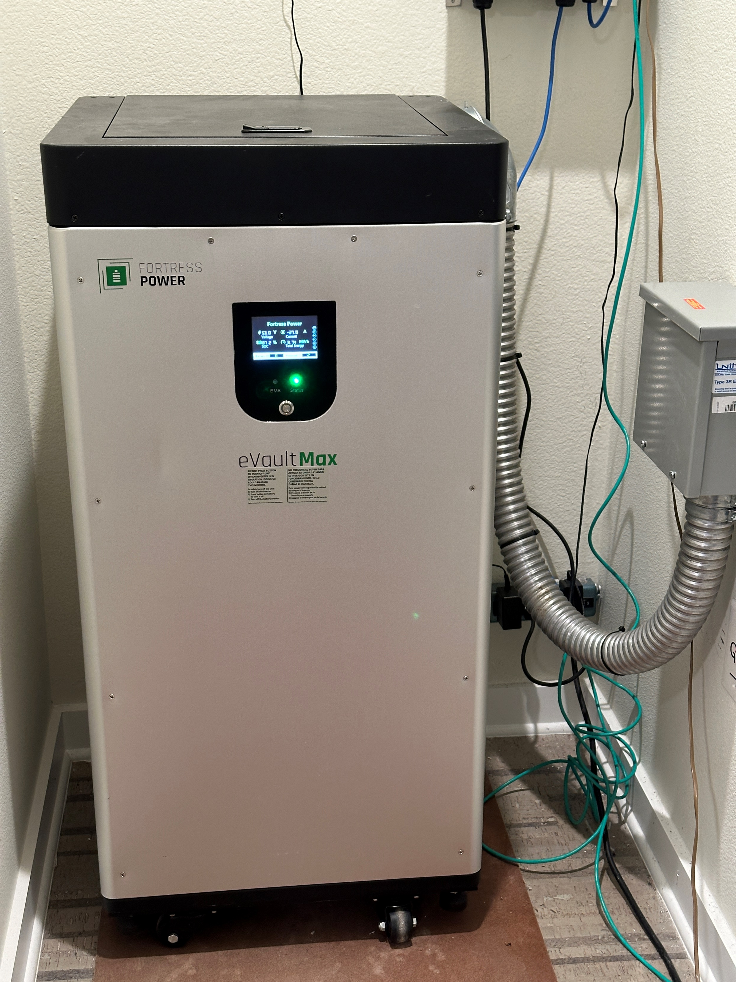
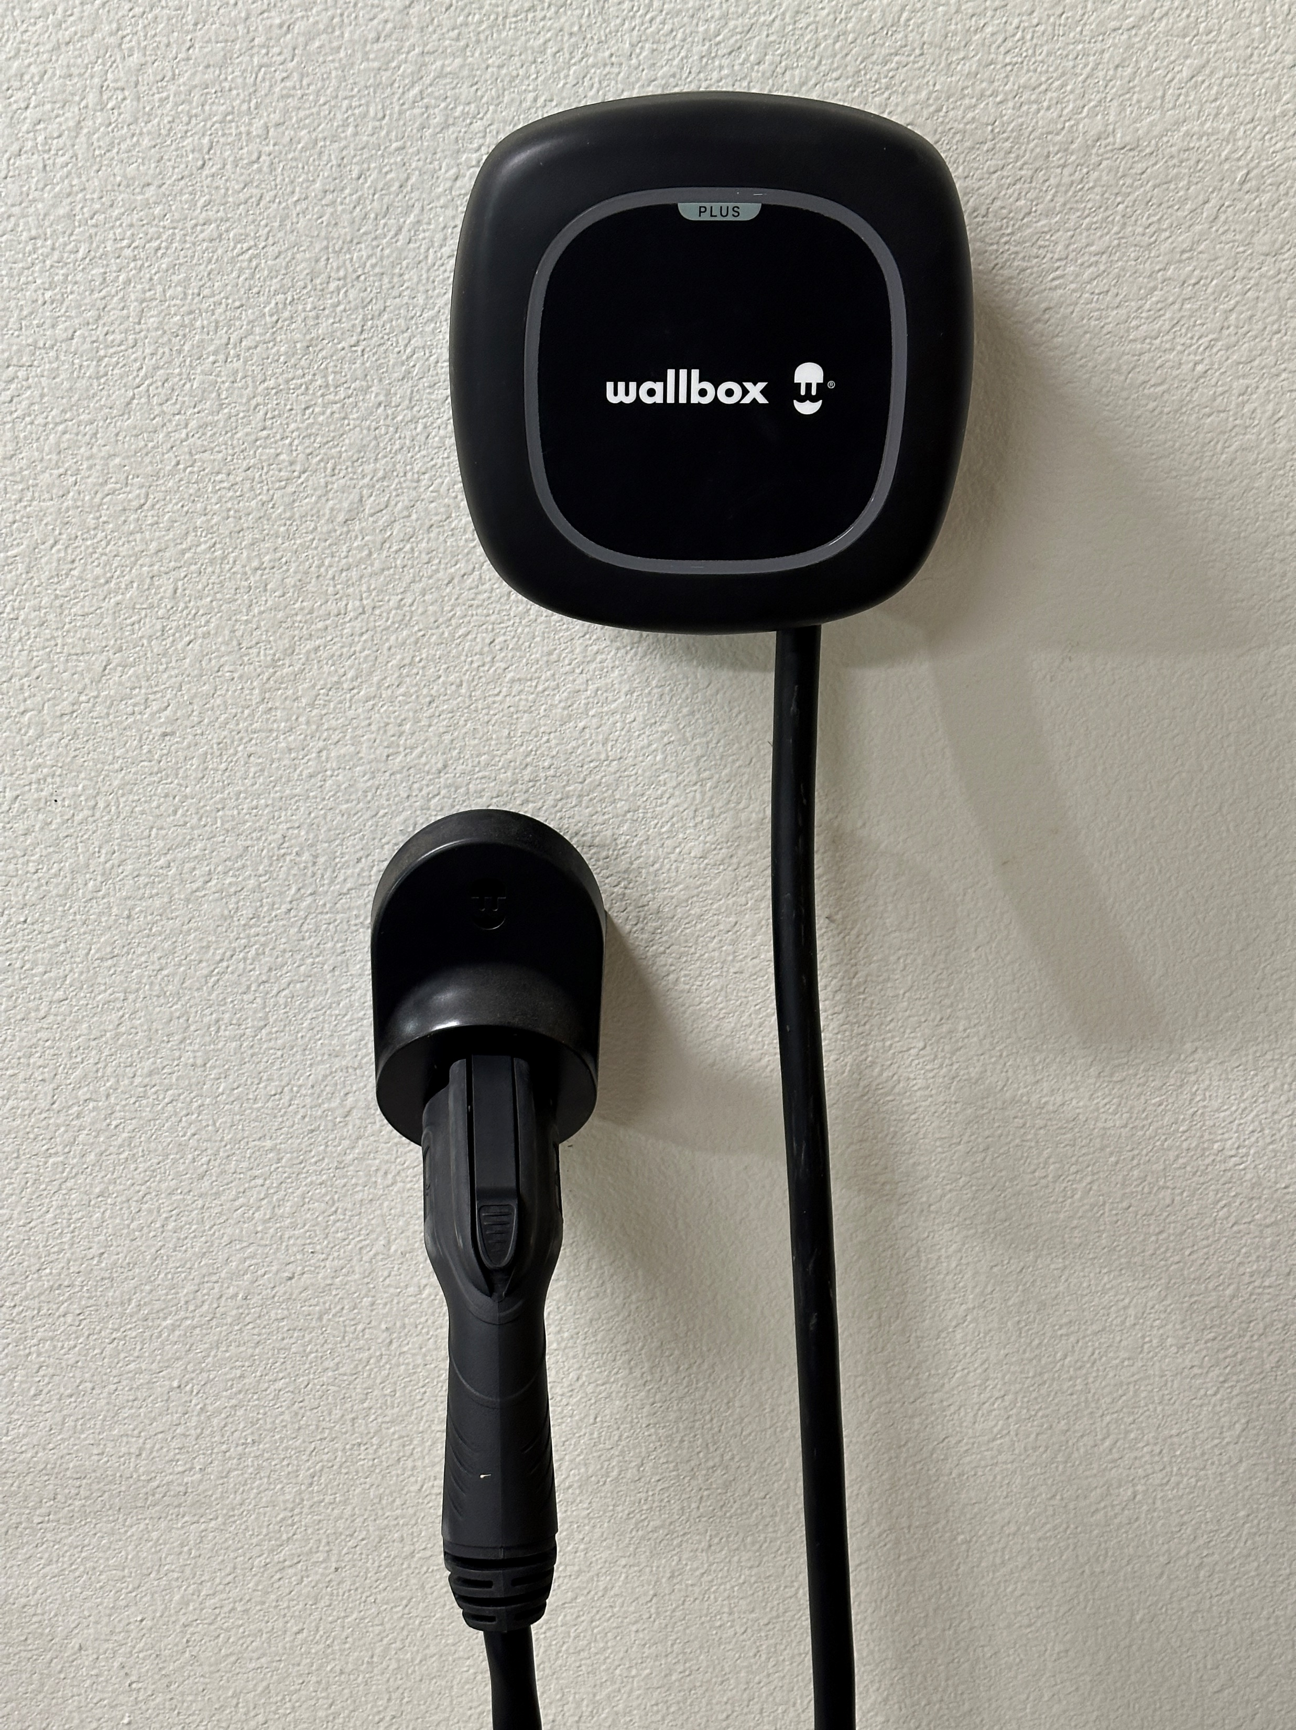
Byrom House Overview by Bill Byrom (Irving TX)

Slide 4


Ozone Action Day Level Red
DFW Area on Friday Sept 25
Ozone is predicted to be at Level Red in the Dallas-Fort Worth area on Friday, September 25. Here are some examples of things you can do to help improve air quality:
Drive an Electric Vehicle
Telecommute, carpool, or vanpool
Bike or walk instead of driving
Take public transit such as DART, Trinity Metro, or DCTA
Reduce idling and observe the speed limit
Children, older adults and people with lung disease, such as asthma, emphysema, or chronic bronchitis, should avoid outdoor activity if ozone reaches Level Red. All other people should limit prolonged outdoor exertion if ozone reaches Level Red.
For more information, visit AirNorthTexas.org

Slide 5
Introduction
This house was built by owner Bill Byrom between 2020-2023. I bought the 30 year old house on this corner in 1994 and lived in it until I decided to replace it with a new custom energy efficient house without foundation, plumbing, and electrical wiring problems.
I moved into the new house in April, 2023. The solar power system was activated in September, 2023. The landscaping is currently being reworked and the drip irrigation pump is being replaced. So although rainwater was supplying irrigation water for many months, at this time city water is temporarily being used.
This is a Zero Energy Building (ZEB). Energy cost in the two years was zero (over $330 credit balance and no monthly energy bill).

Slide 6
Features of this house
All-electric zero energy building (ZEB)
Solar power system
  14.4 kW DC: 36 X 400 W solar panels (Q.Peak DUO BLK ML-G10)
  Tigo TS4-A-O optimizers for each solar panel (provides quick disconnect)
  Sol-Ark 15K system inverter (this is the heart of the solar power system)
  Fortress Power Vault Max 18.5 kWh LiFePO4 ESS storage battery
Wallbox Pulsar Plus Level 2 EV charger (mfg in Arlington, TX)
  Installed to support 40 A (9.6 kW) maximum charge rate at 240 VAC
Ground Source Heat Pump HVAC and hot water system: 6x250 ft deep

Slide 7
Additional features
Raised seam metal roof (rainfall runoff feeds drip irrigation system)
Insulated energy saving motorized window shades
Large elevator and circular staircase for second level access
App-controlled smart house features
  LED room lighting, vent fans, and room fans
  Motorized exterior door locks
  HVAC system control and monitoring
  Exterior garage overhead door control with cameras
  My Sol-Ark remote control and monitoring of solar power system

Slide 8
Zero Energy Building (ZEB) Definition
A zero energy building (ZEB) produces enough renewable energy to meet its own annual energy consumption requirements, thereby reducing the use of non-renewable energy in the building sector.
ZEBs use all cost-effective measures to reduce energy usage through energy efficiency and include renewable energy systems that produce enough energy to meet remaining energy needs.
There are a number of long-term advantages of moving toward ZEBs, including lower environmental impacts, lower operating and maintenance costs, better resiliency to power outages and natural disasters, and improved energy security.
Reducing building energy consumption in new building construction or renovation can be accomplished through various means, including integrated design, energy efficiency retrofits, reduced plug loads and energy conservation programs. Reduced energy consumption makes it simpler and less expensive to meet the building’s energy needs with renewable sources of energy.
Source: “A Common Definition for Zero Energy Buildings” prepared for the US Department of Energy by the National Institute of Building Sciences

Slide 9
First Year Solar System Results
Conditioned area: 3,143 sq ft all-electric building with natural gas consumption of 0 therms (no gas or propane service to house)
First year house + EV charging electrical load: 10,102 kWh
First year solar power system PV production (AC): 21,612 kWh
First year grid electrical power import (purchase from grid): 2,221 kWh
First year grid electrical power export (sell to grid): 12,186 kWh
First year net export sales to grid (export - import) surplus: 9,965 kWh
First year grid discharge from ESS storage battery (load shifting): 3,614 kWh
First year total house energy load: 34.5 MMBtu (used by my house and EV)
First year total grid energy surplus: 34 MMBtu (sold to grid)
Total energy cost in the first year of operation: Zero (no monthly bill was due and over $170 accumulated credit for the year).

Slide 10
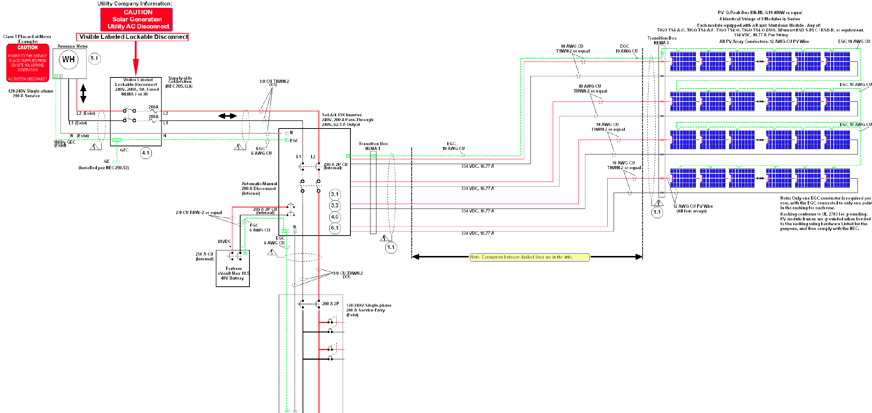
Solar Power System

Slide 11
Sun Angle Effect on Solar Power System
The Earth’s axis is tilted at about 23.5 degrees to our solar orbit, producing differing maximum sun angles to the horizon through the year at our latitude of 32.8 degrees north:
  57.2 degrees sun height at vernal (March 20) and autumnal (Sept 22) equinox
  33.8 degrees sun height at winter (Dec 21) solstice
  80.6 degrees sun height at summer (June 20) solstice
My south-facing roof (containing solar panels) is angled at 30 degrees, producing maximum output at a sun height of (90-30)=60 degrees. This is close to optimum for our latitude. The roof faces directly south and the power output follows a modified cosine curve each day.
The maximum power from the solar panels should be near the equinoxes, when the peak sunlight is directly orthogonal to the panels. Energy production during the summer is increased due to the long days, but the panel output is reduced by 0.34% per degree C. The output in the winter is reduced due to shorter days. Thick clouds reduce the output significantly.

Slide 12
Operation of the Solar Power System
PV (photovoltaic) power from the 36 solar panels can be used to advantage in several ways:
  If the house load (including EV charging) is higher than the PV output, the solar power reduces the import (purchase) of grid energy. Small systems with only a few solar panels can significantly reduce their energy expense. This is true even if the system is not set up to sell energy to the grid.
  If the PV output exceeds the house load and the system is set up for bidirectional metering, the system can sell power to the grid. Unfortunately, current REP plans typically pay much less for grid export than for import.
  If the system has a large ESS (Energy Storage System) battery, the house may be able to operate all (or most) of the night using the battery, then recharge the following day. This is called load shifting and can reduce your bill.

Slide 13
Effect of Solar Power System on Electric Bill
My REP (Retail Electric Provider) is Green Mountain Energy (GME). I have a solar buy-back plan. Here are details of my particular multi-year plan:
Import from grid: $0.10307/kWh + ~$0.05/kWh Oncor delivery charge
Export to grid: -$0.05307/kWh per month
Note that the Oncor delivery charge and taxes can significantly increase the cost of energy imported from the grid (purchased). The effective cost of importing energy is about 3X what I receive by exporting my solar energy to the grid through GME.
My total GME bill calculation estimate as of July, 2024, is:
$14.61 + (Import)(0.15395 / kWh) - (Export)(0.054662) / kWh)
You can see that if I reduced my import from the grid to zero, I would still owe $14.61 per month if I was not exporting to the grid. In real world conditions, I need to import a little each day to make it easy to run my system. So I need to export back sufficient energy to overcome what I’m buying and the fixed $14.61 expense. Because I’m not paid straight 1:1 as with full net metering but more like 1:3, I need a large system and ESS battery load shifting to get my bill to zero. I had one positive bill this past year (Jan 2024 for $6.38), but my accumulated credits left me with zero due.
I purchased my EV on March 1, 2024. So I may have more positive monthly electric bills going forward, but I believe that I will have a sufficient credit balance to cover this. GME will not pay me back with cash.

Slide 14
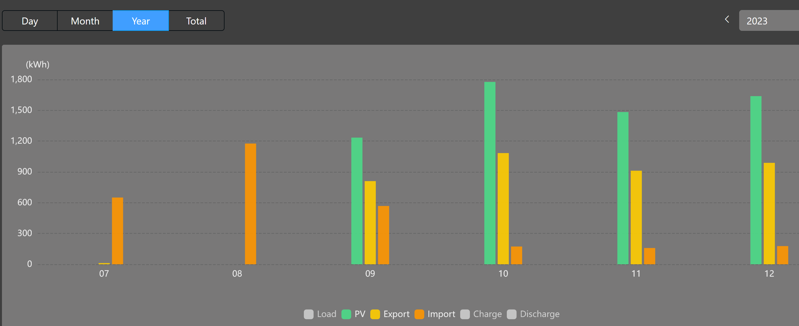
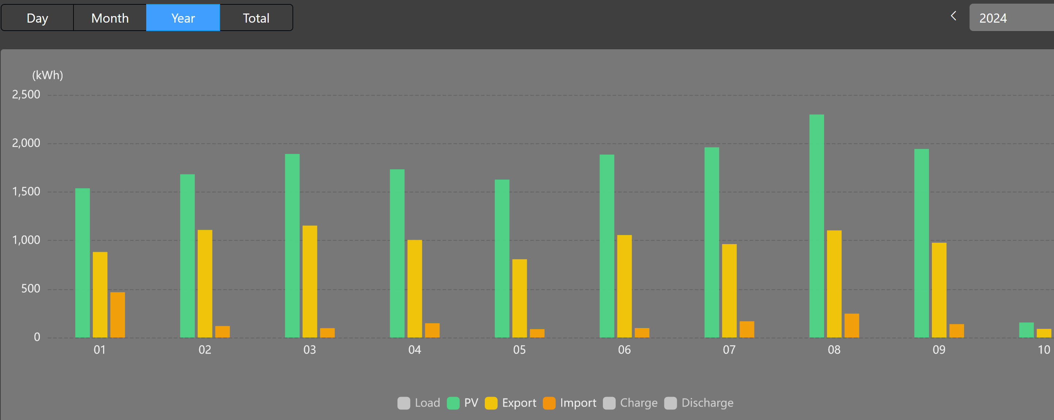
Solar System PV Generation and Grid History
Green: PV solar generation
Yellow: Export to grid (sell)
Orange: Import from grid (buy)
System activated 9-11-2023

Slide 15
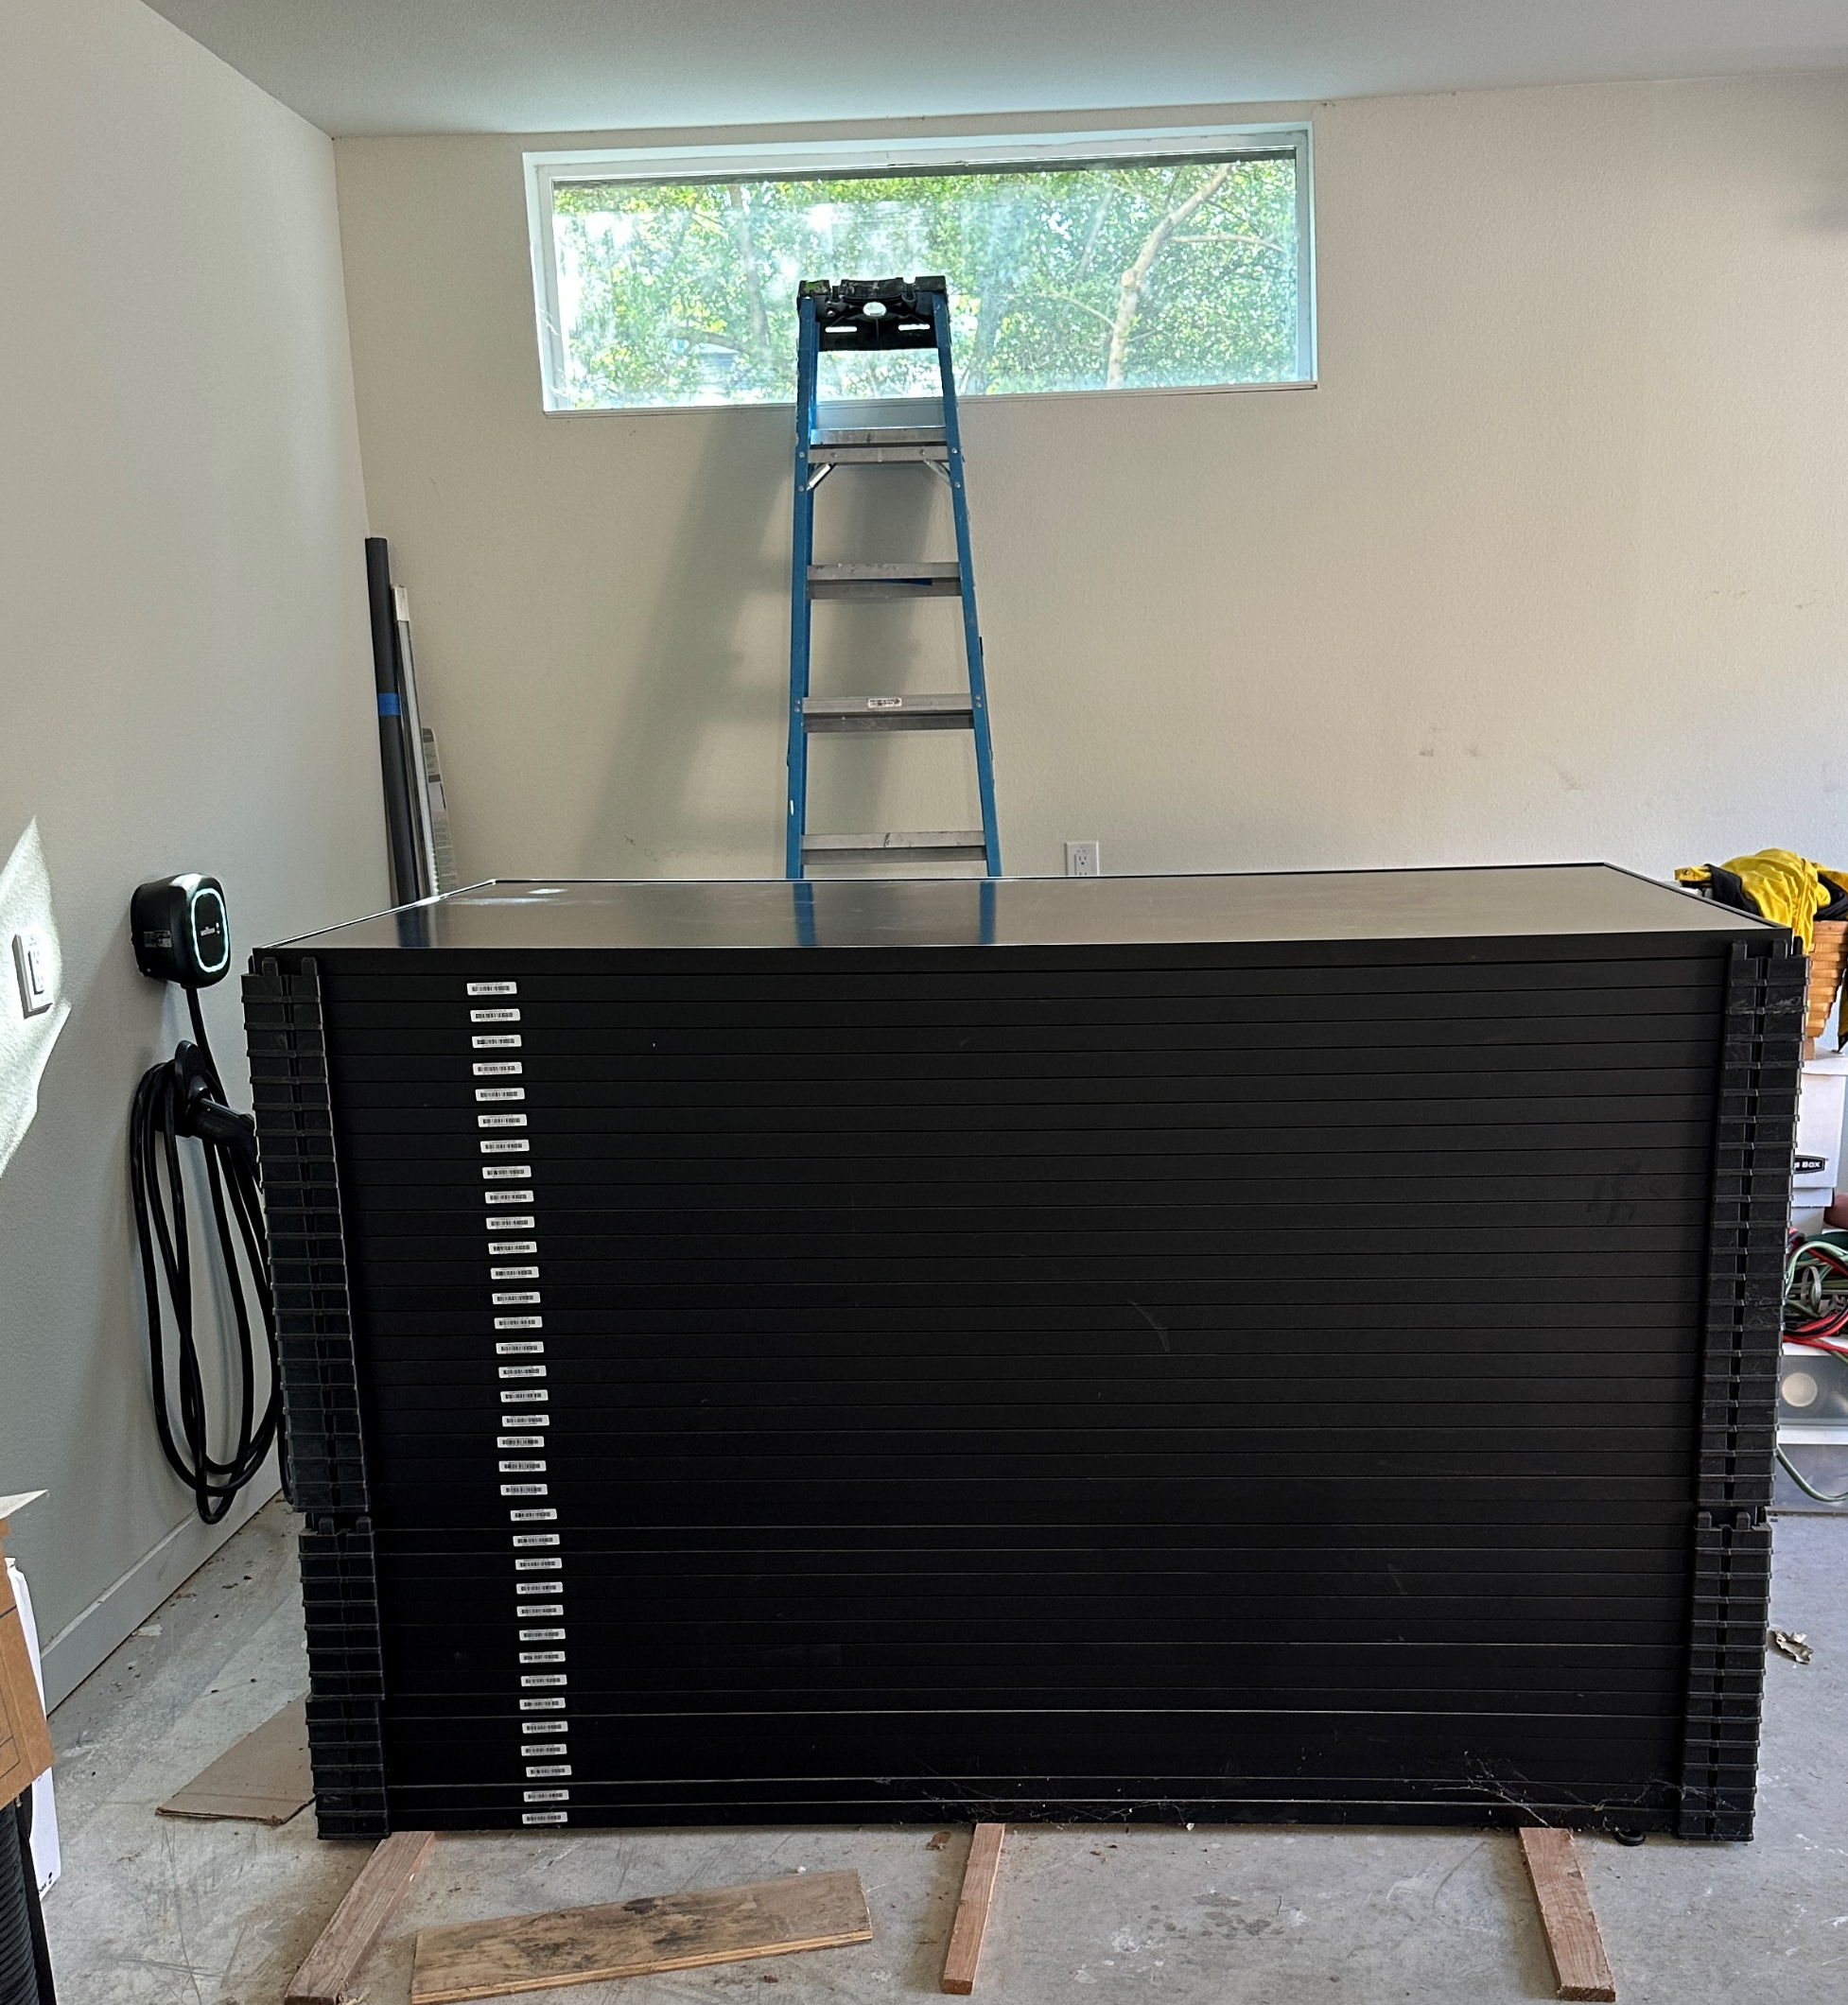
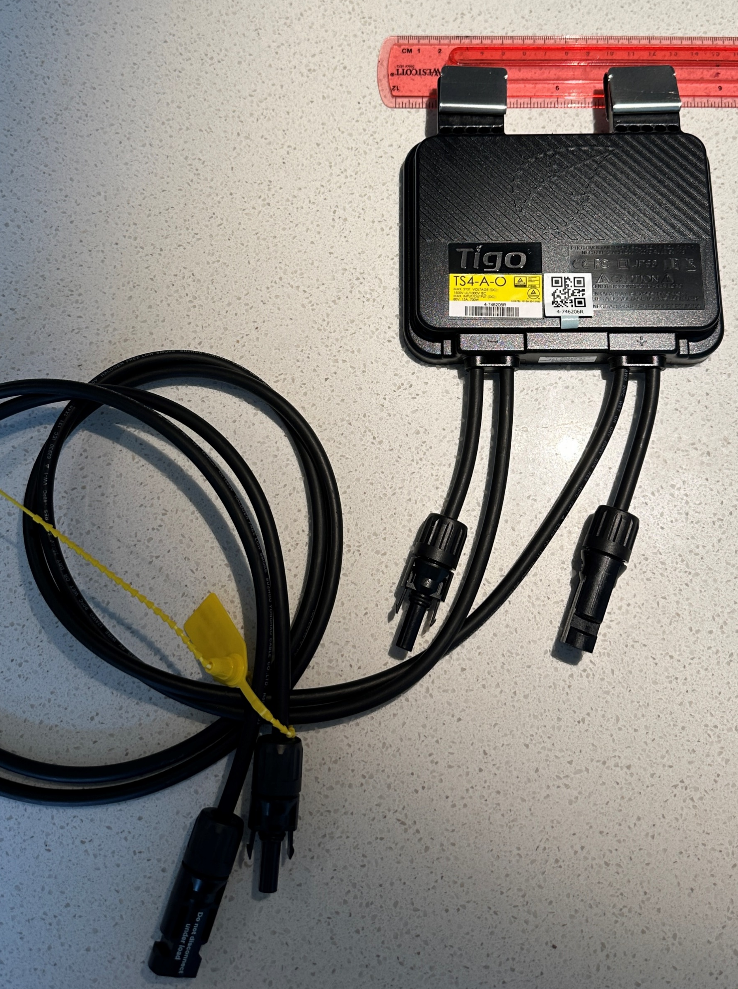
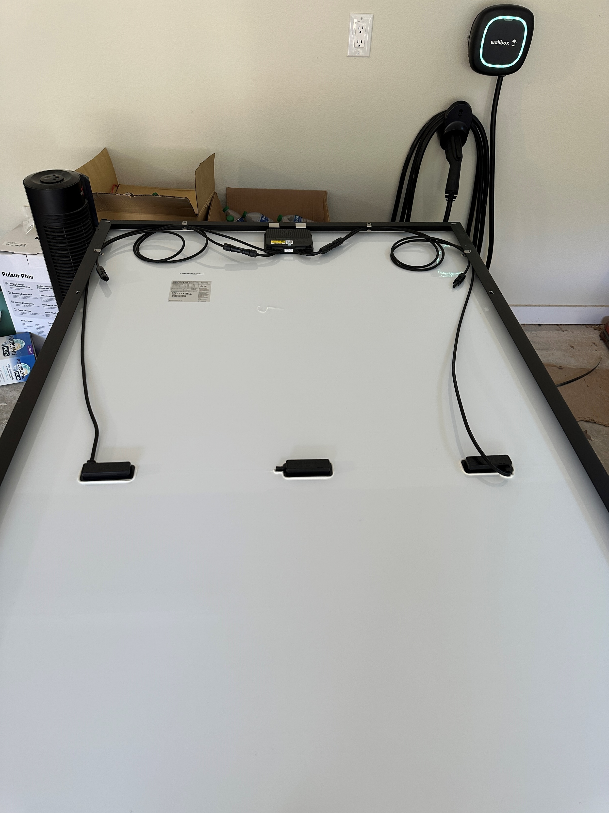

Slide 16
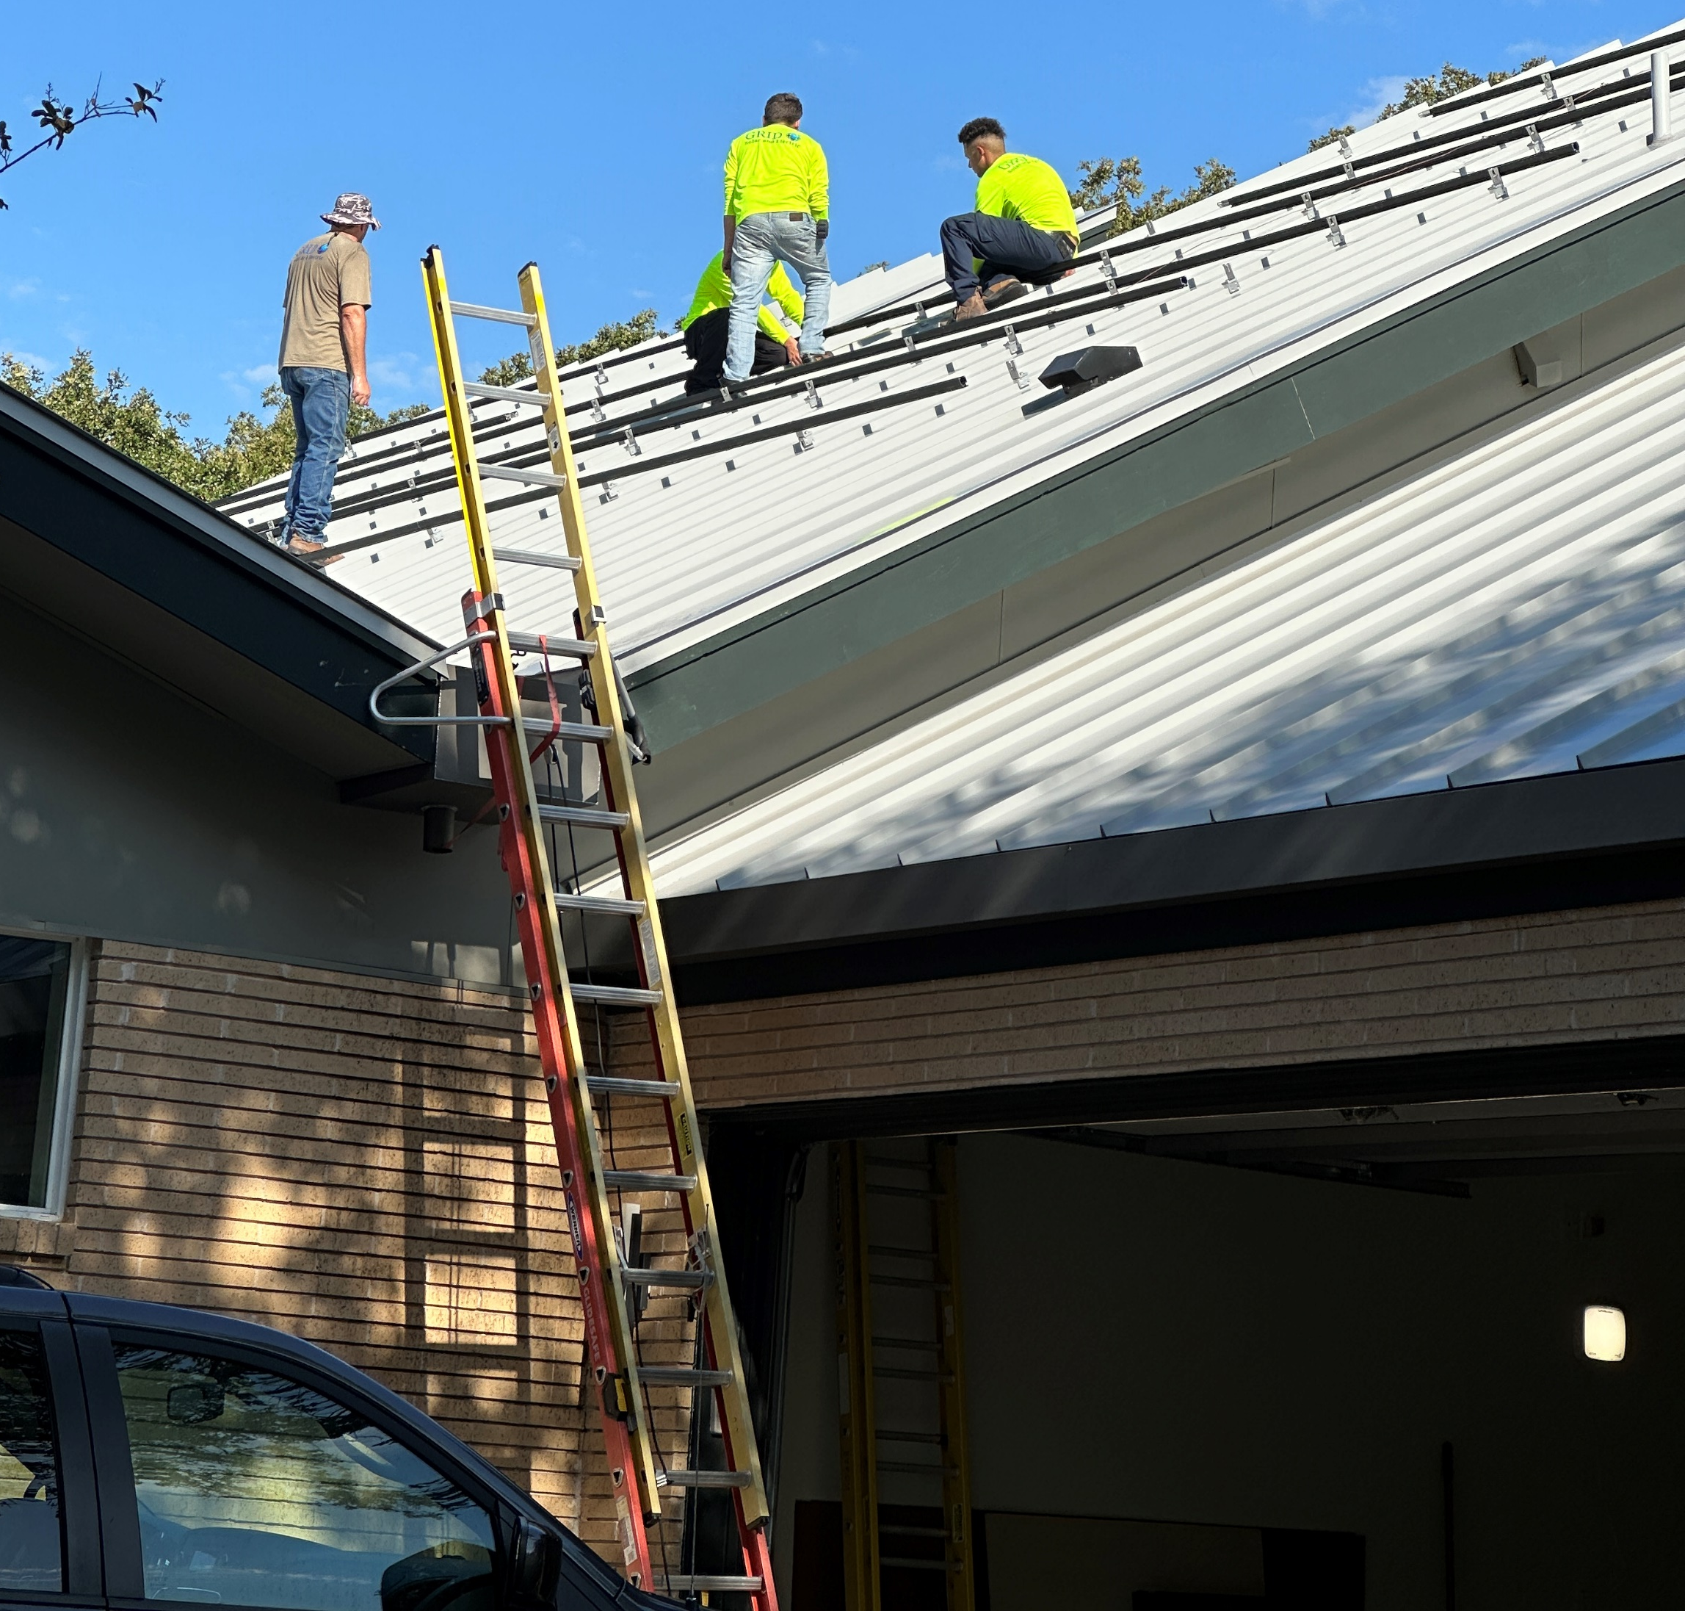
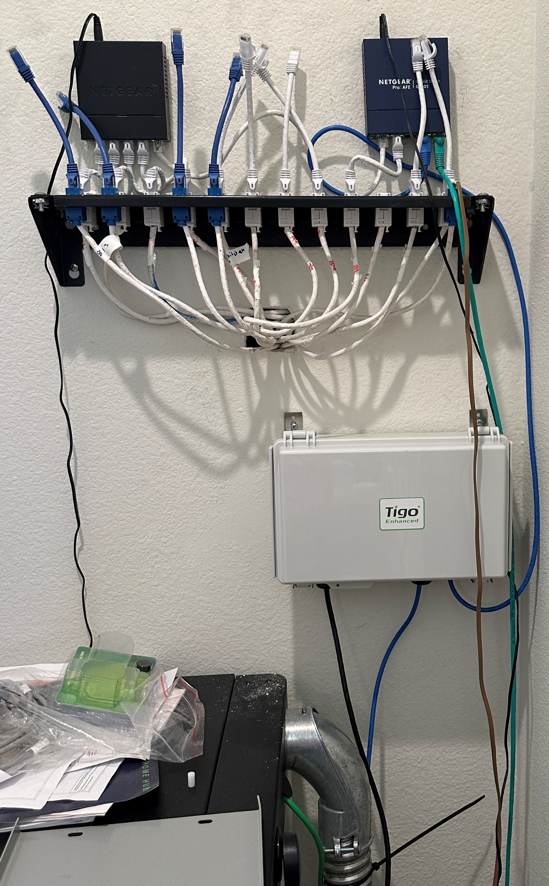
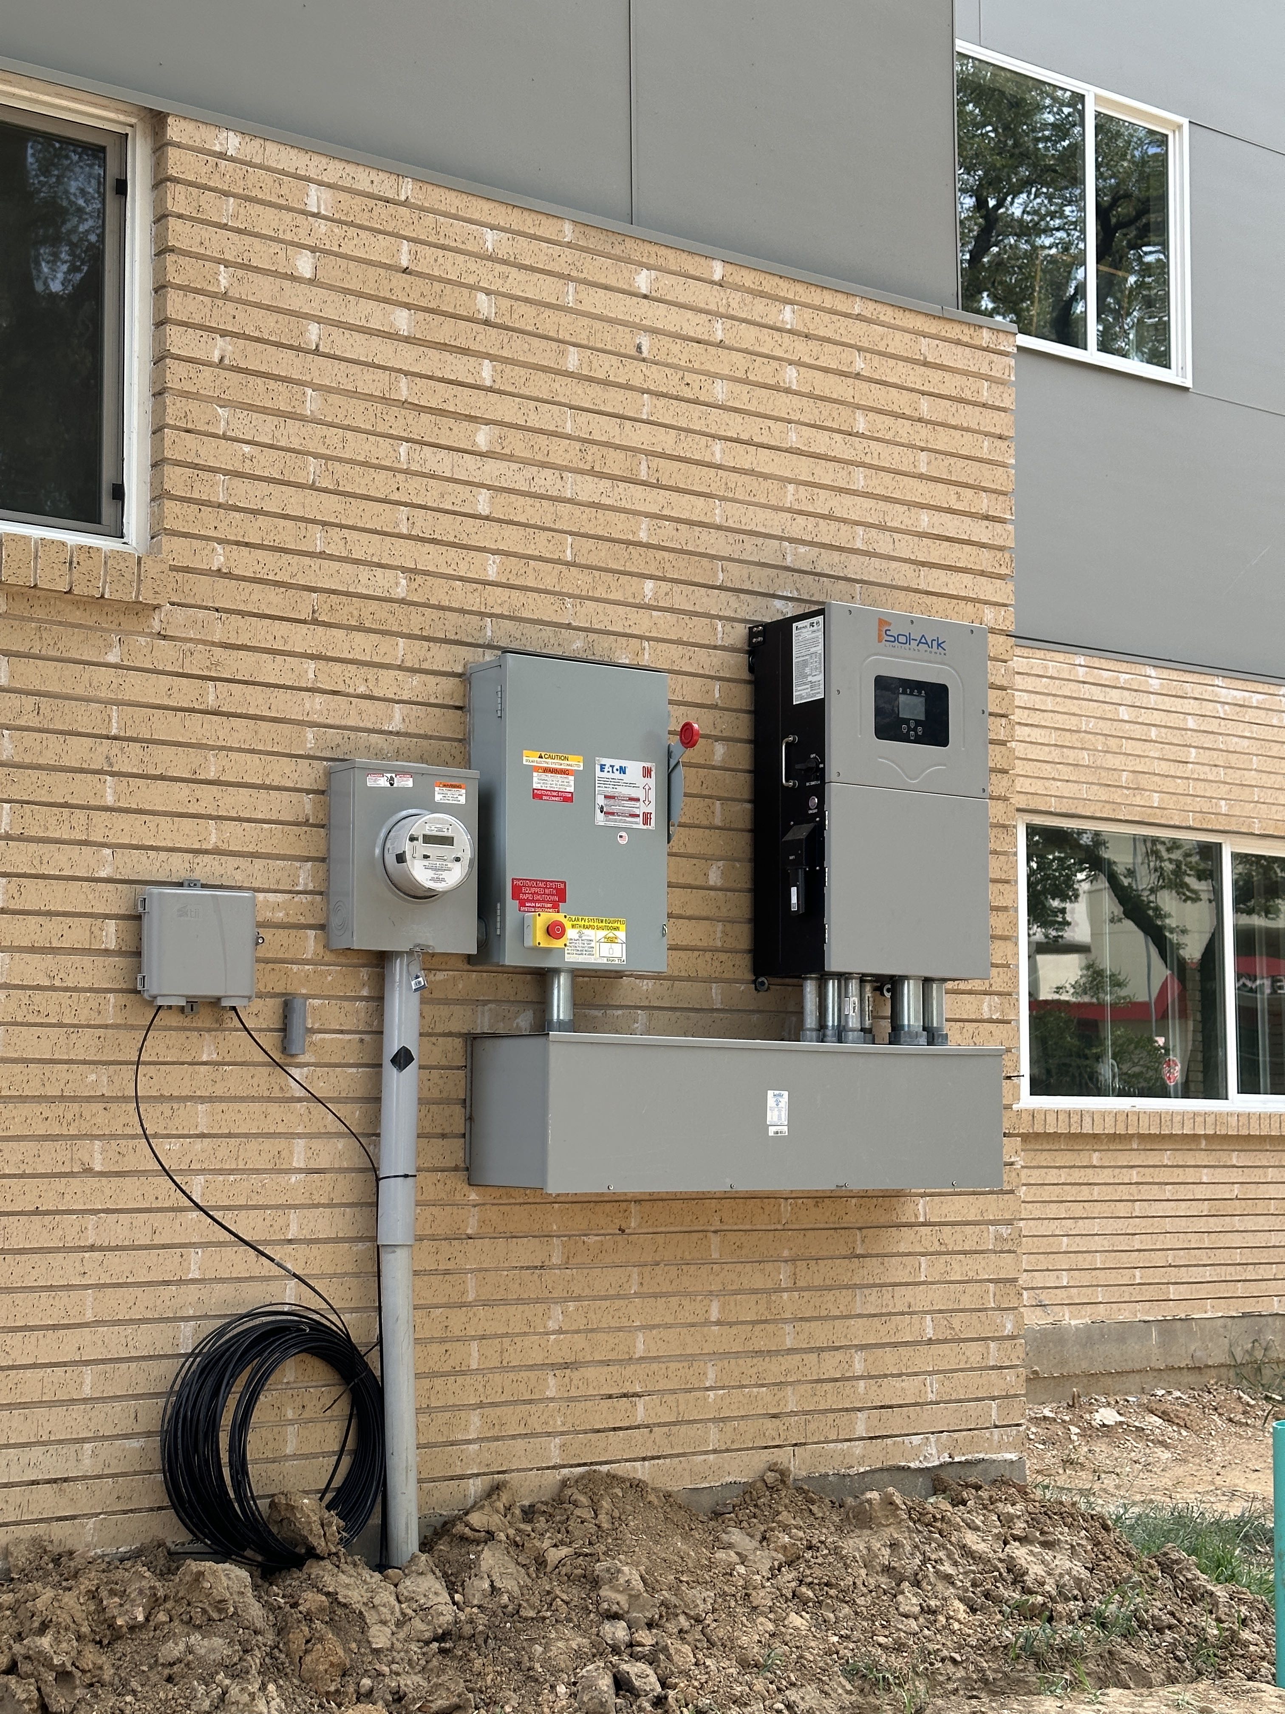

Slide 17
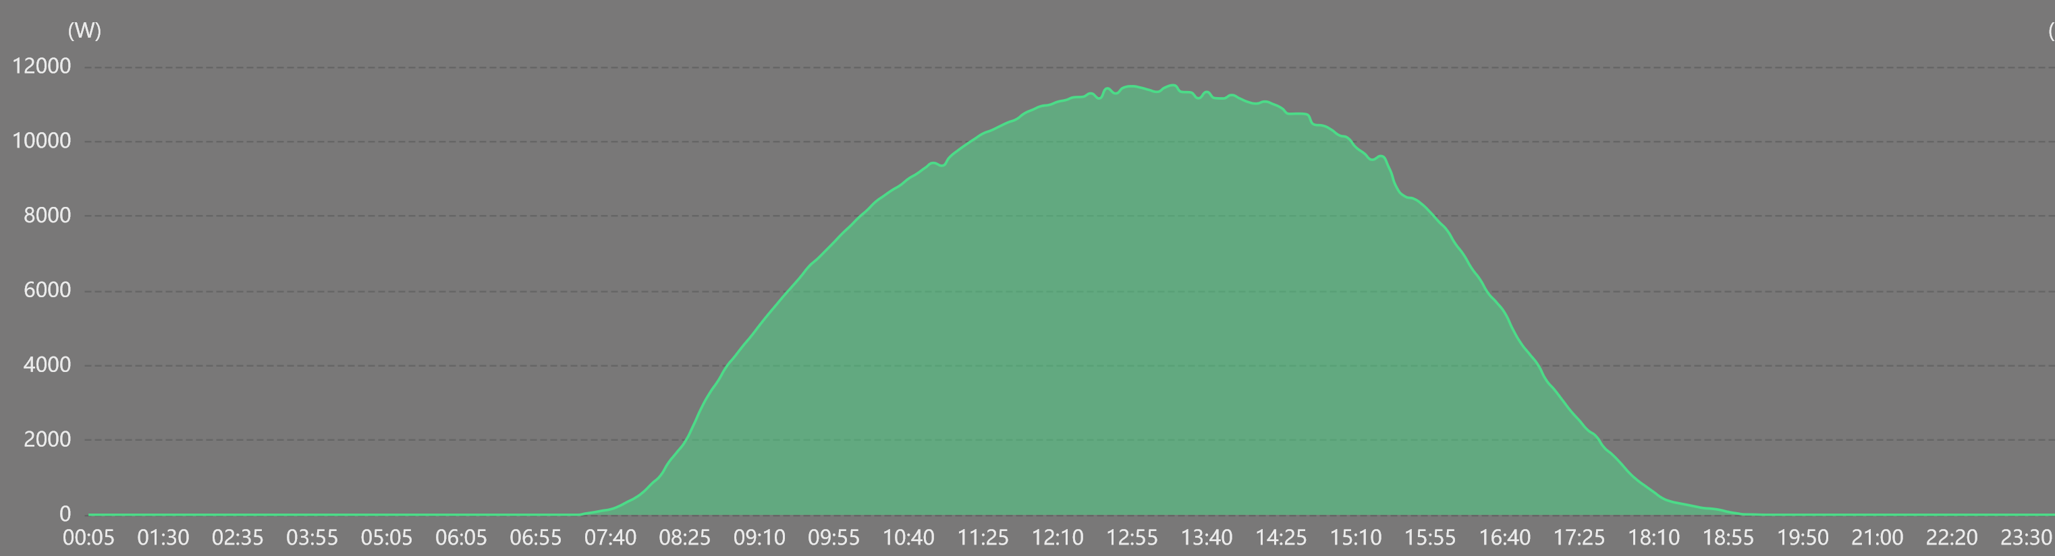
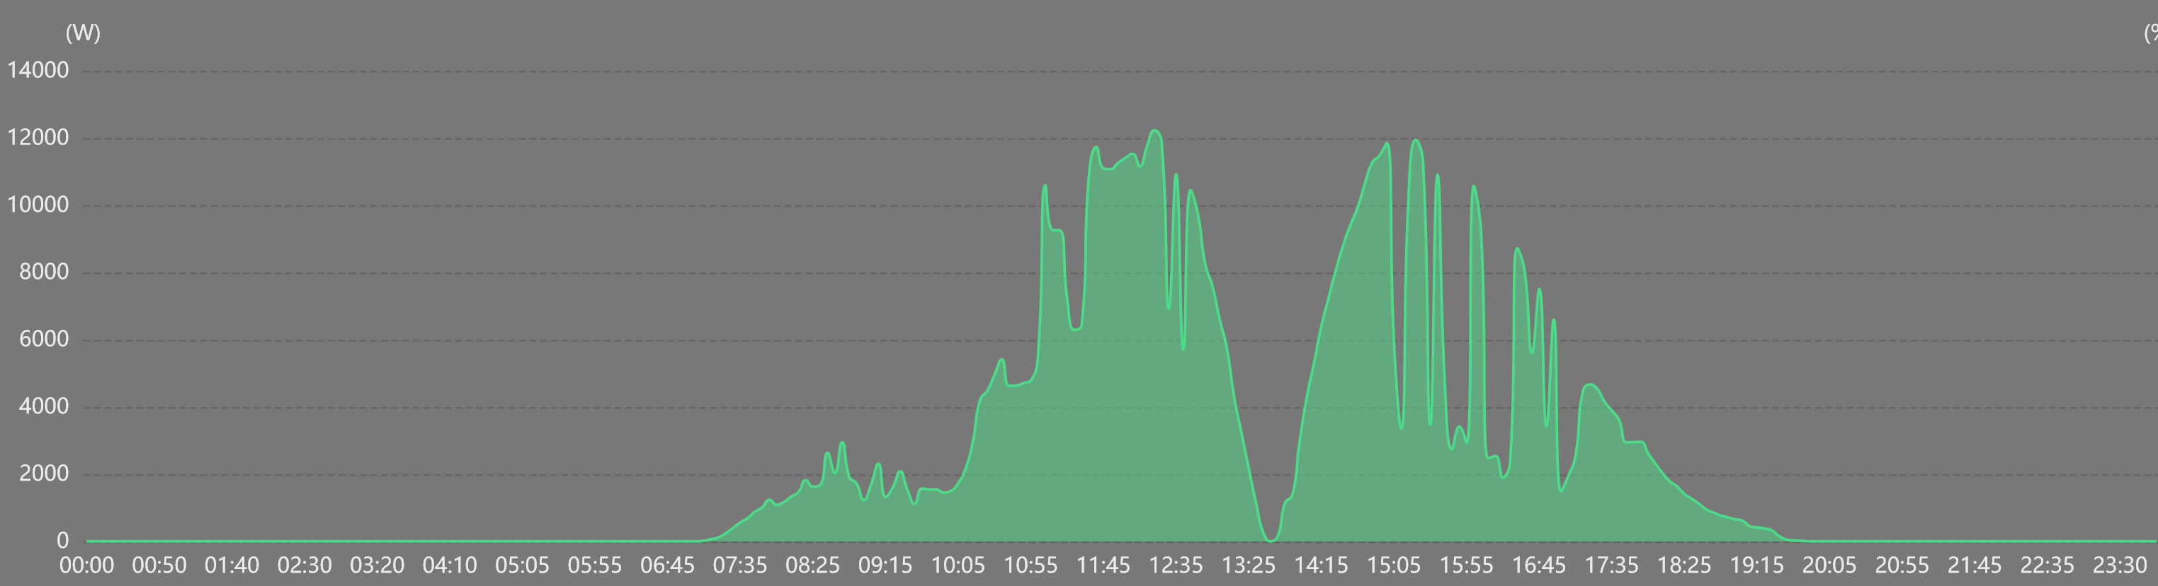
PV Generation on Clear and Cloudy Days
Wed Oct 1, 2024
Mon April 8, 2024

Slide 18
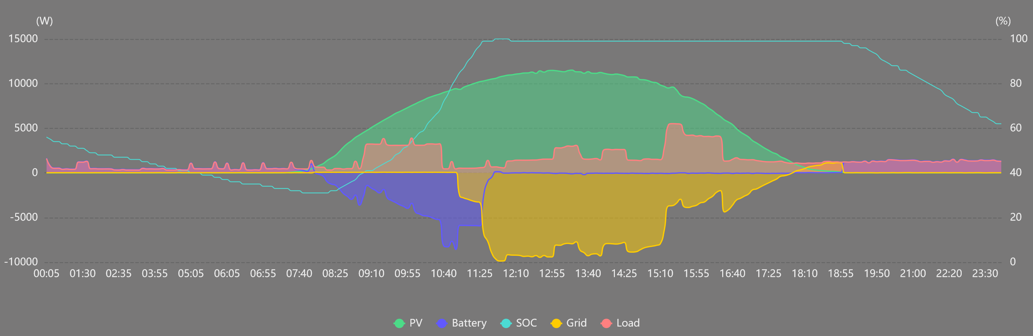
Load Shifting Using ESS Battery
My Fortress Power ESS battery can power my house for most or all of the night (depending on temperature and appliance use). The Sol-Ark system inverter is programmed to favor battery use at night. As soon as the sun rises the next morning, the battery is recharged (usually by noon). Energy is exported (sold to the grid) each afternoon and only a small amount of energy is imported (purchased from the grid) before sunup and around sundown. If it’s very cloudy less is exported and more is imported from the grid. Below is an example of a clear day (Oct 1, 2024) with EV charging starting at 9 AM and 3 PM. My dishwasher also ran.

Slide 19
Additional House Features
Elevator (large enough for motorized wheelchairs)
Natural cork water resistant flooring
Motorized insulated window shades on most lower level windows
Ground source heat pump
  Six 275 ft deep geothermal boreholes were drilled in the back yard
  Water circulates in underground tubing through these boreholes
  A refrigerant-based heat pump in the attic transfers heat between the house and the large underground rock volume beneath the back yard
  This is the most efficient HVAC system available, with a SEER rating of 56
Smart house control and monitoring of many systems
Attention during construction to full insulation of all walls and attic areas
Noise reducing wallboard material on lower level to reduce sound transfer
Energy efficient windows

Slide 20
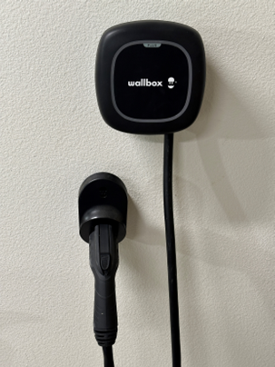
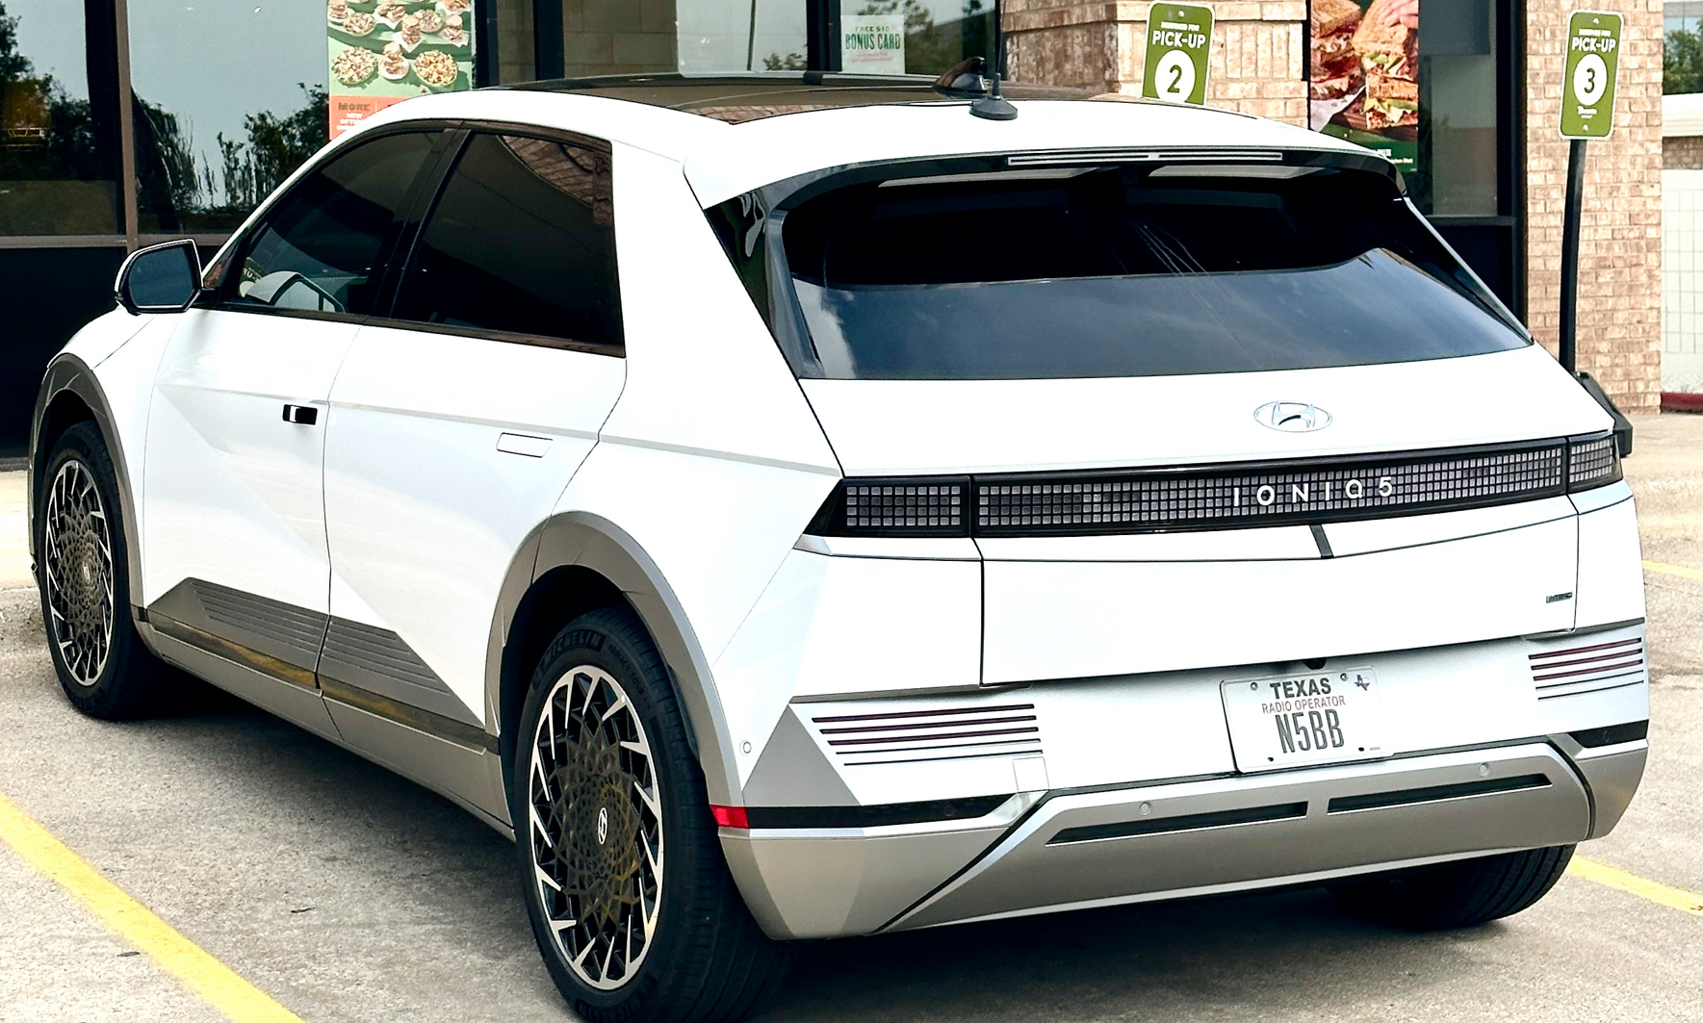
Hyundai IONIQ 5 EV with Wallbox charger
AWD (dual motor, four wheel drive) full electric SUV
Original EV battery and power train warranty: 10 years / 100,000 miles
Electrify America charging plan ends 1 Mar 2026 (free 30 min fast DC charges)
Battery: 77.4 kWh (about 230 – 260 mile range)
Typical around town mileage: ~ 3 mi/kWh (330 wH/mi)
Charge rate with Wallbox home level 2 charger (set to 40 A maximum at 240 VAC):
@6A (1.44 kW) >> 30 min / 1% charge level
@10A (2.4 kW) >> 20 min / 1% charge level
@20A (4.8 kW) >> 10 min / 1% charge level
@40A (9.6 kW) >> 5 min / 1% charge level
Charge time from 20% to 80% SOC: ~5 hours @40A
Vehicle can be charged using 120/240 VAC or fast DC charging

Slide 21
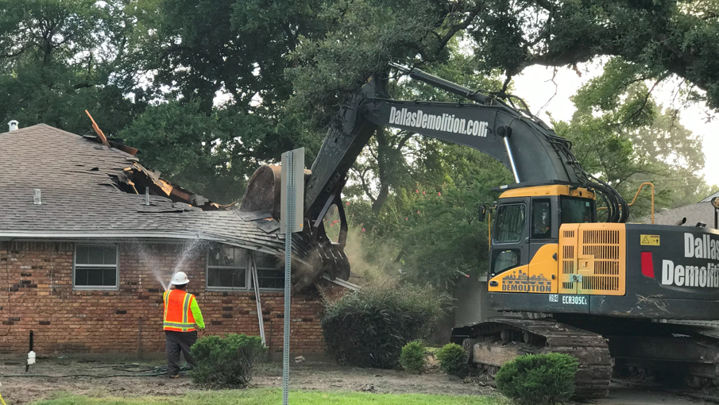
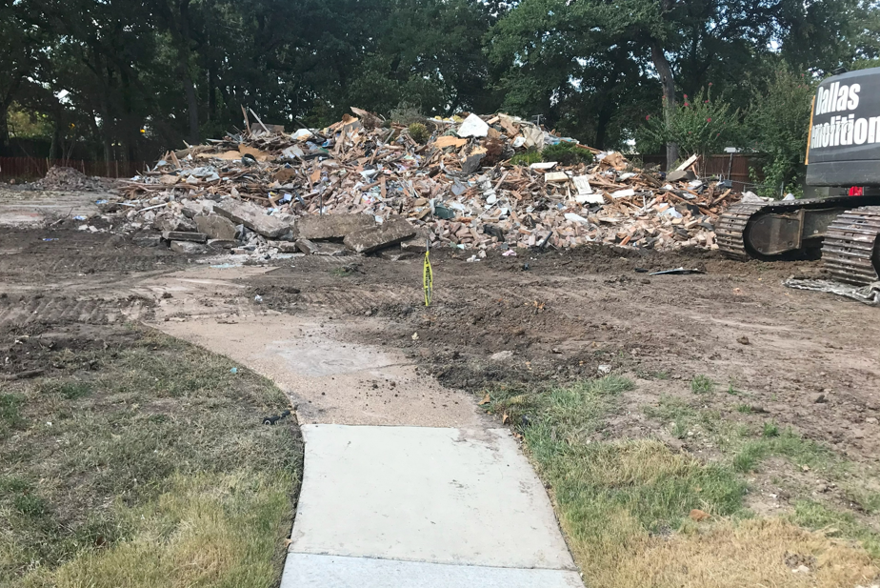

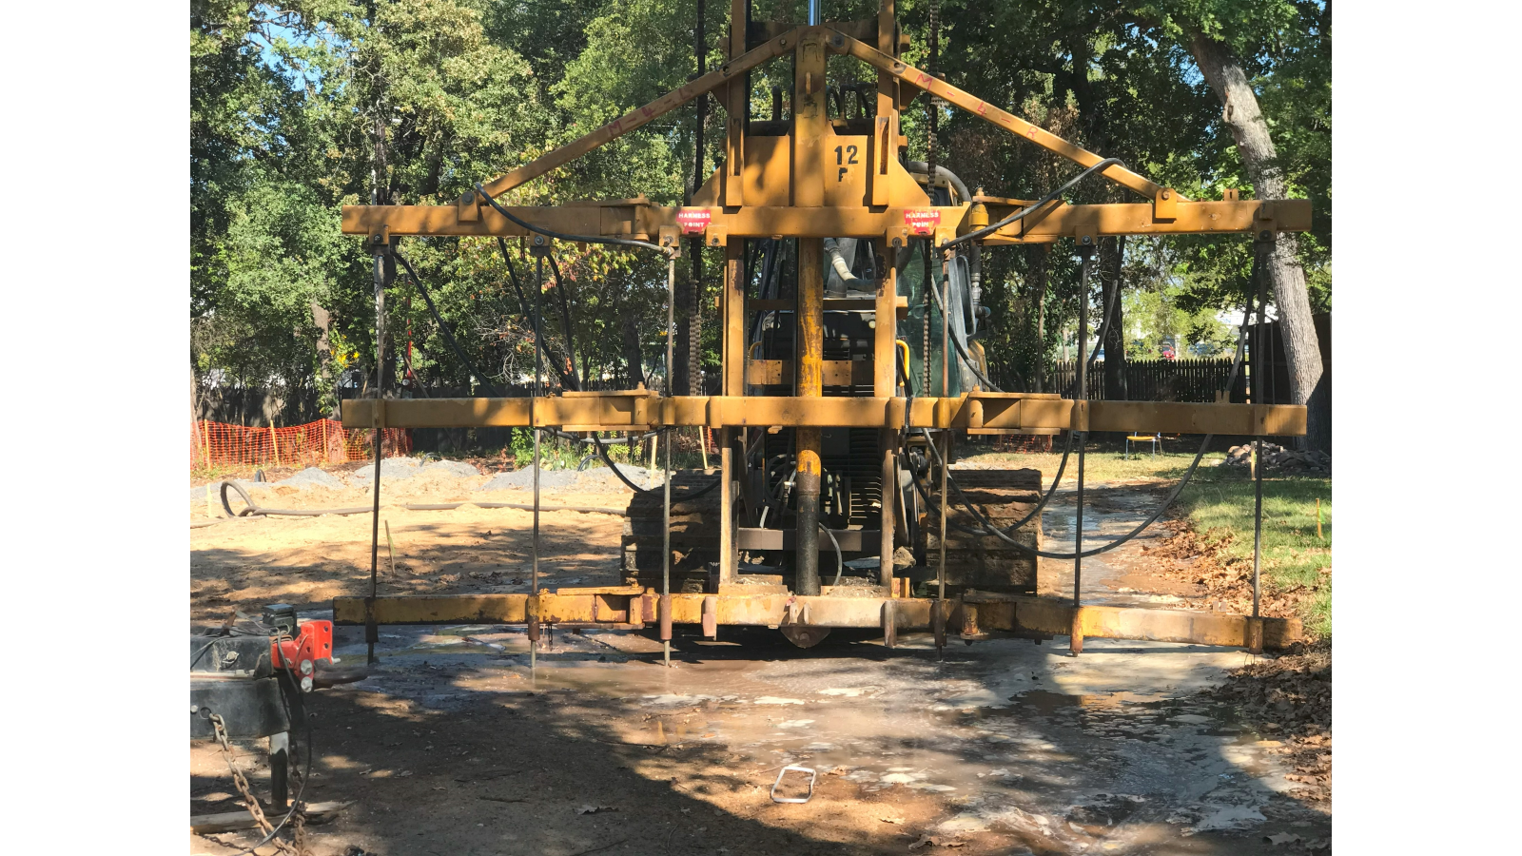

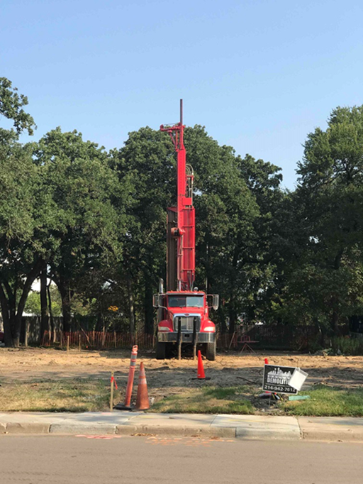
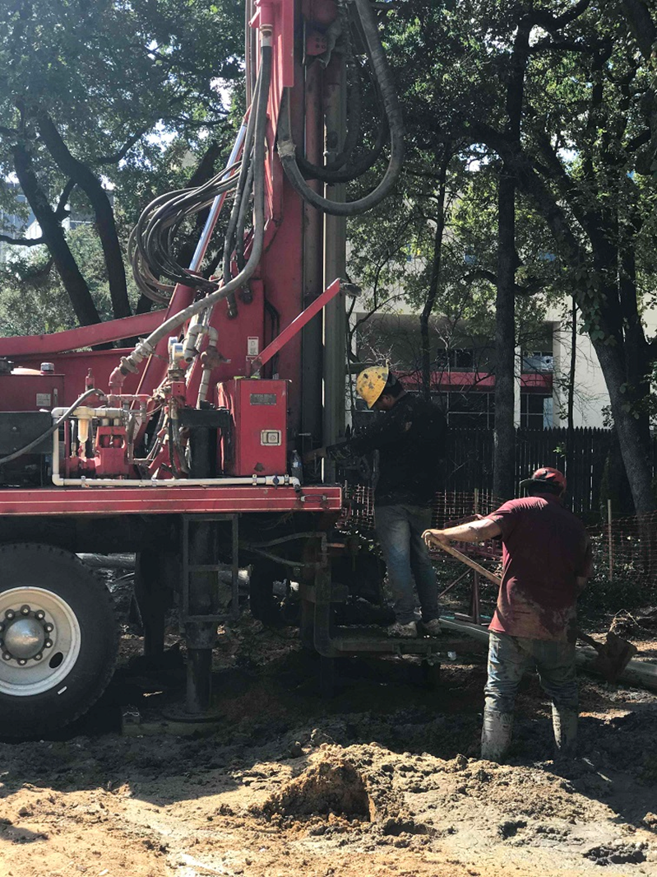
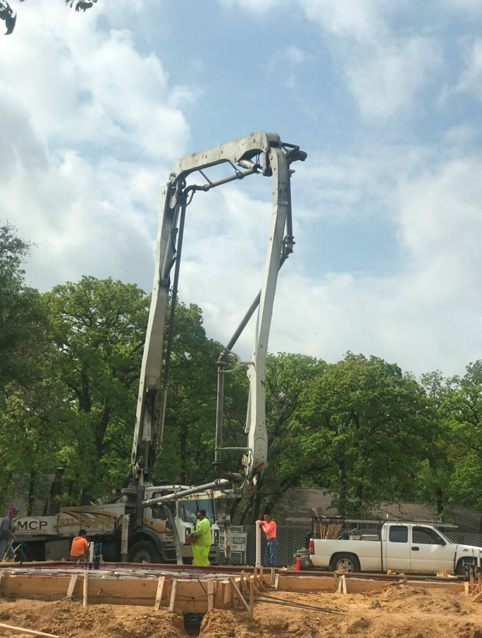
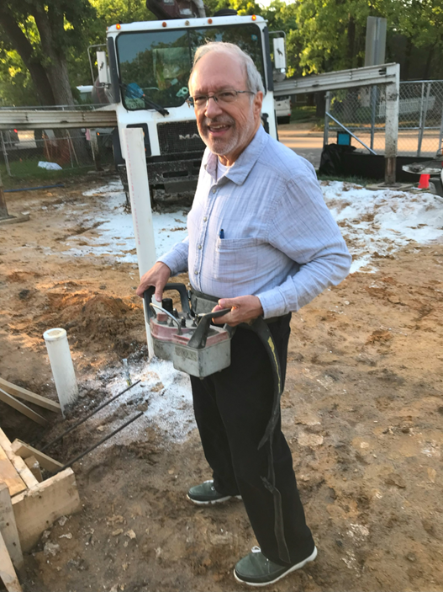
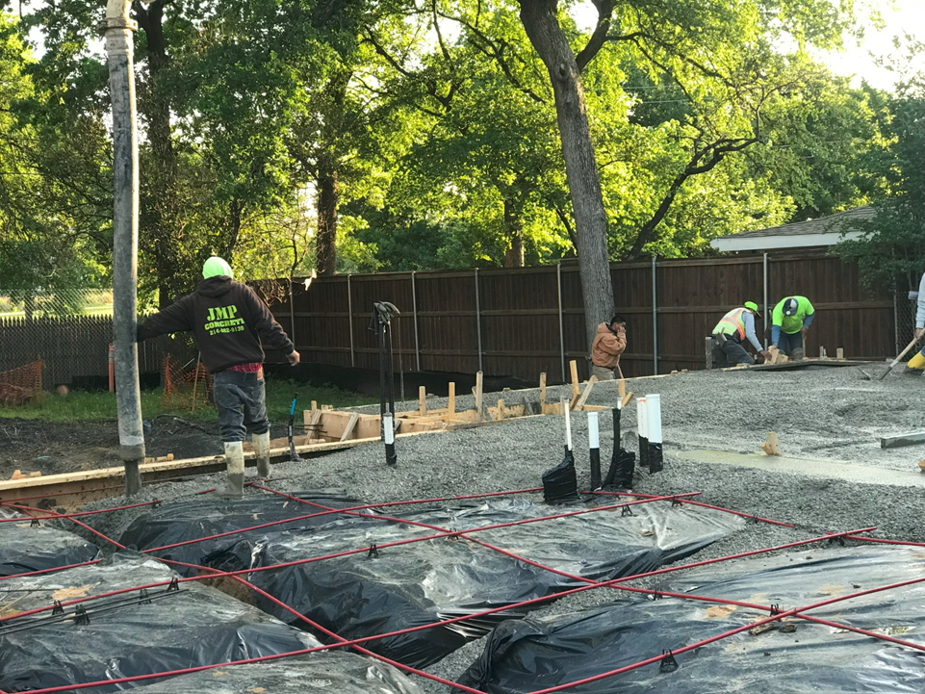
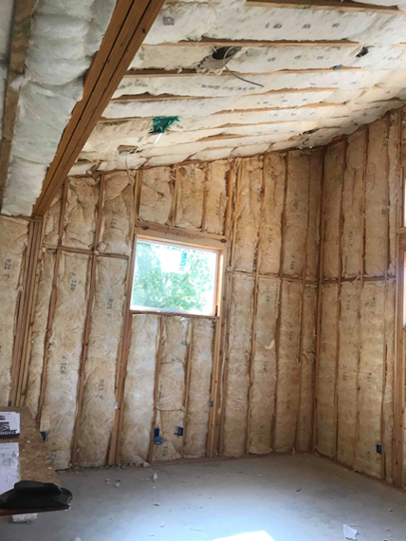
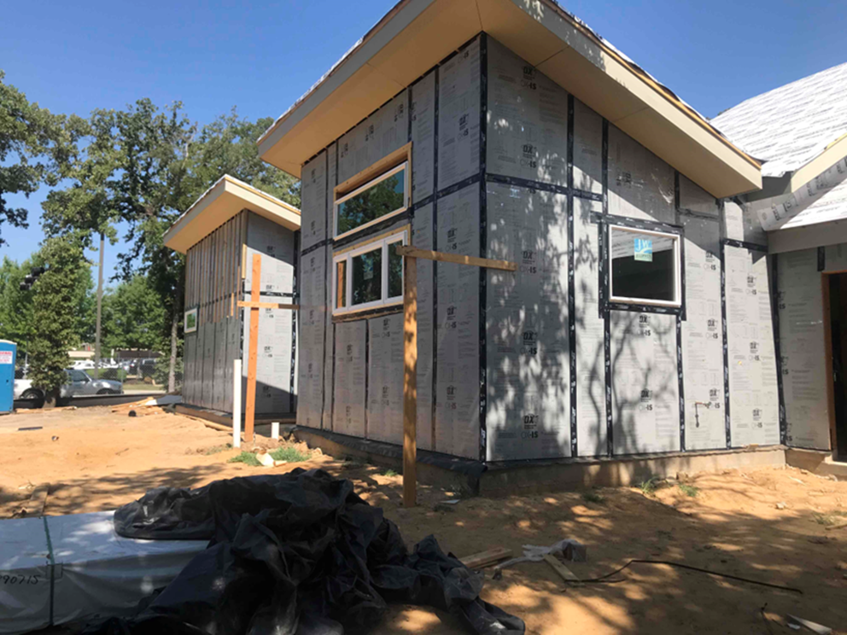
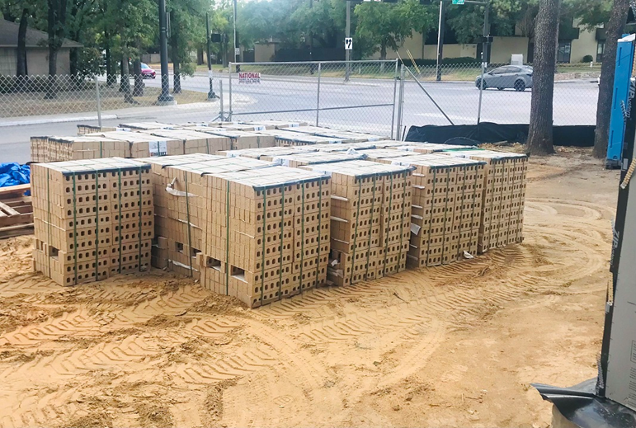

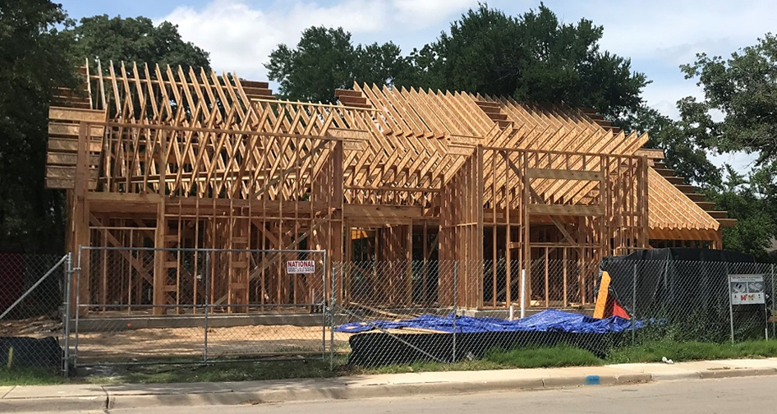
Demolition & New House Construction Photos

